Slide 1

An NSS Audio-Visual
Library Presentation
The Best of the
1993 NSS Photo Salon
National Speleological Society
S916 81 Slides 2/28/2021

Slide 2
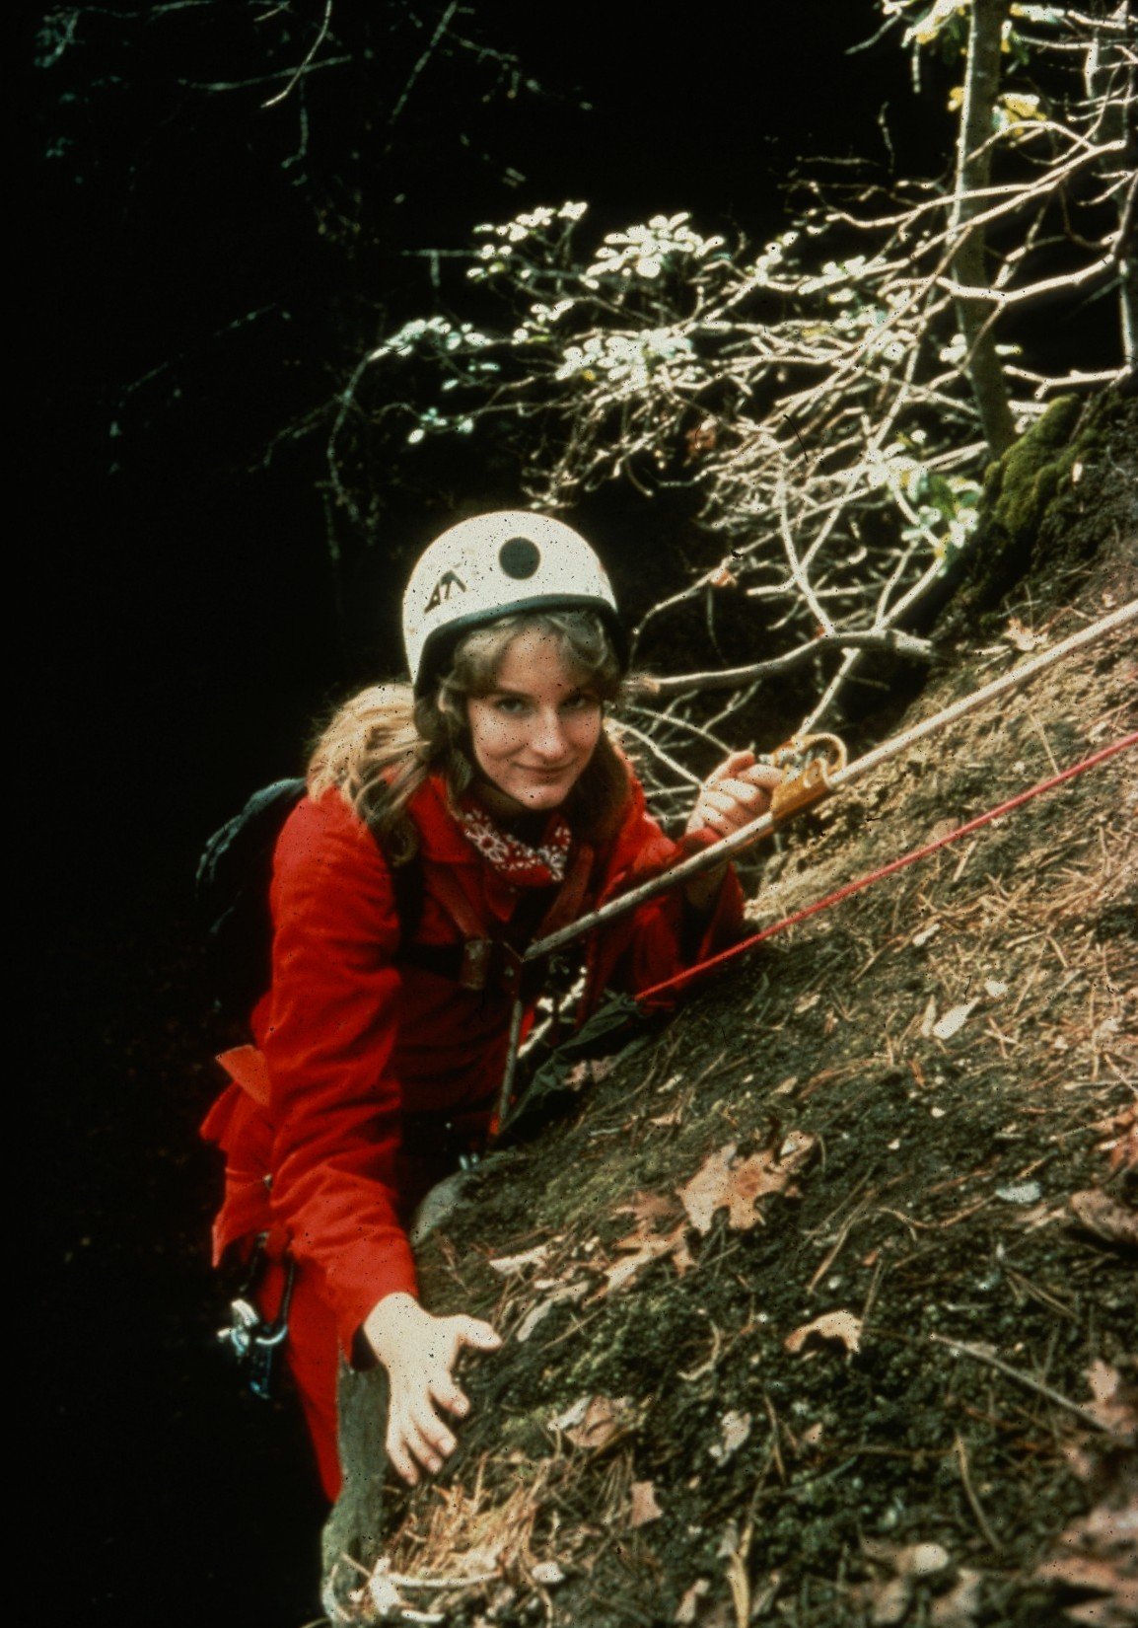
Notes:
Breaking Over – John Van Swearingen, IV

Slide 3
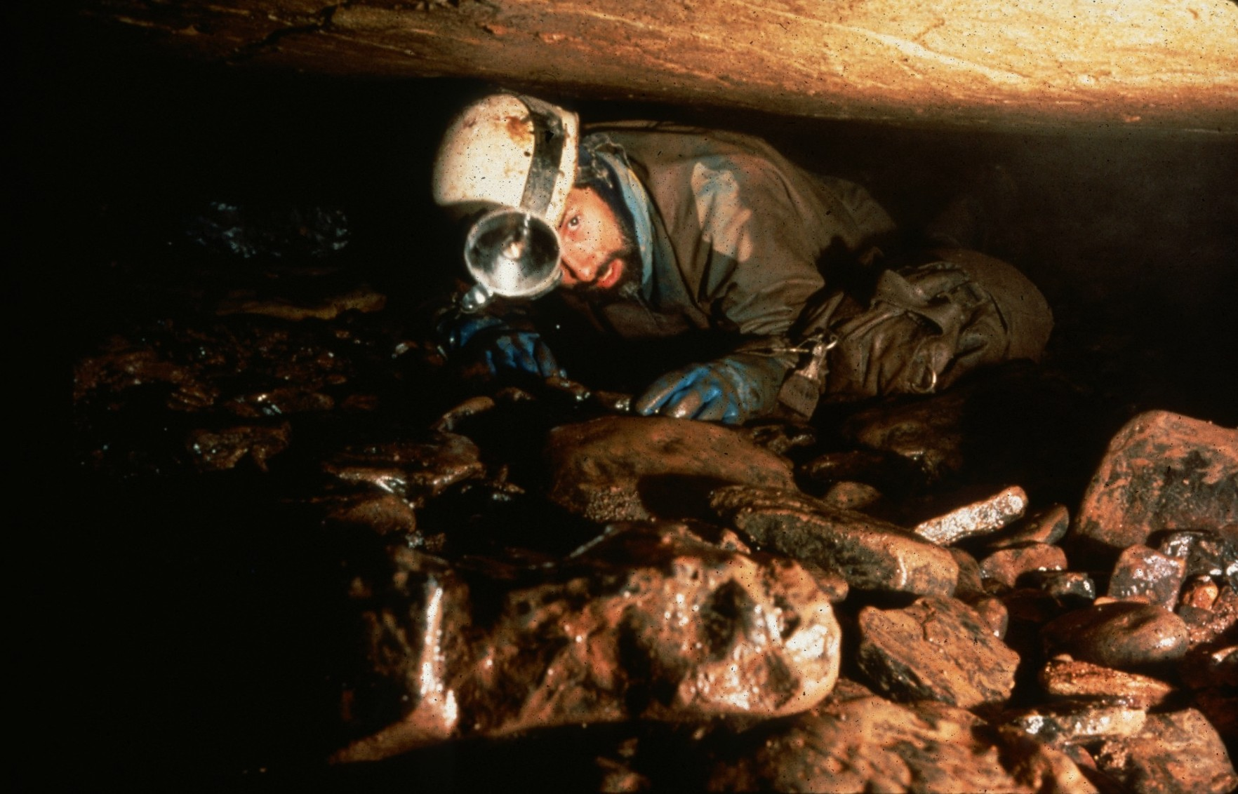
Notes:
Oh, Those Cobbles – Ron Simmons

Slide 4
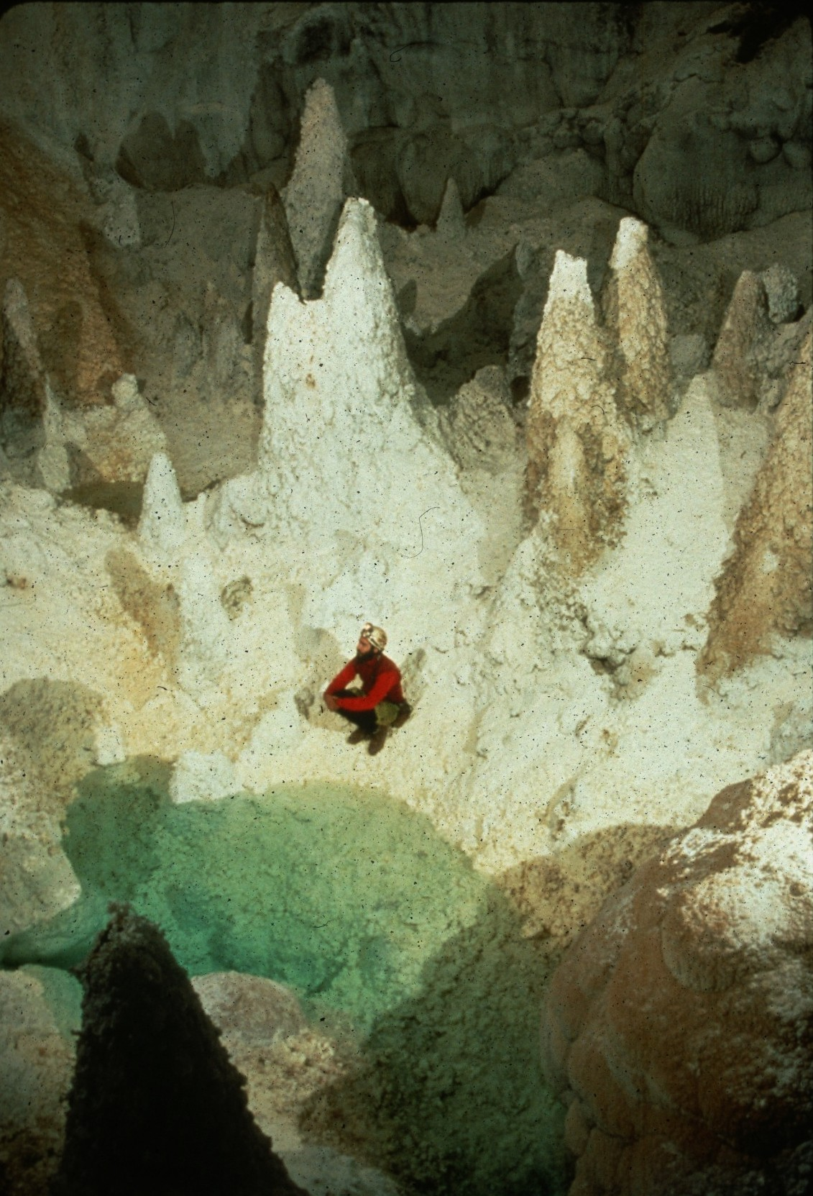
Notes:
Hoodoo You Do? – Peter and Ann Bosted

Slide 5
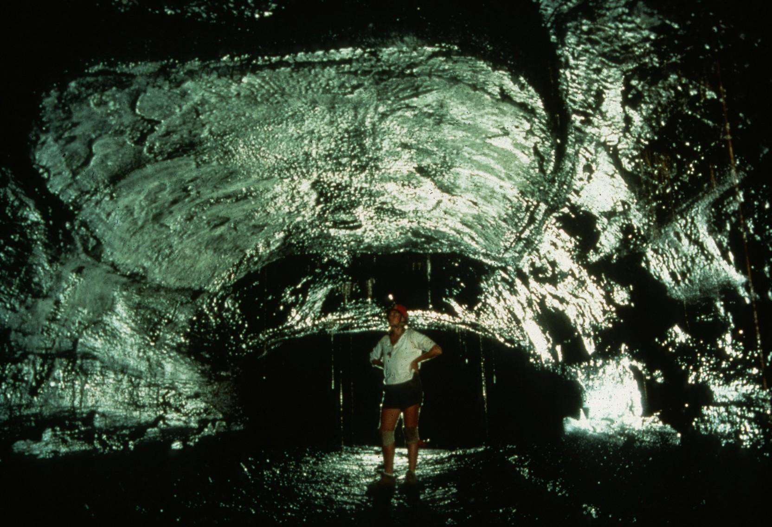
Notes:
Skylight Plug, Kazamura Lava Tube – Dave Bunnell

Slide 6
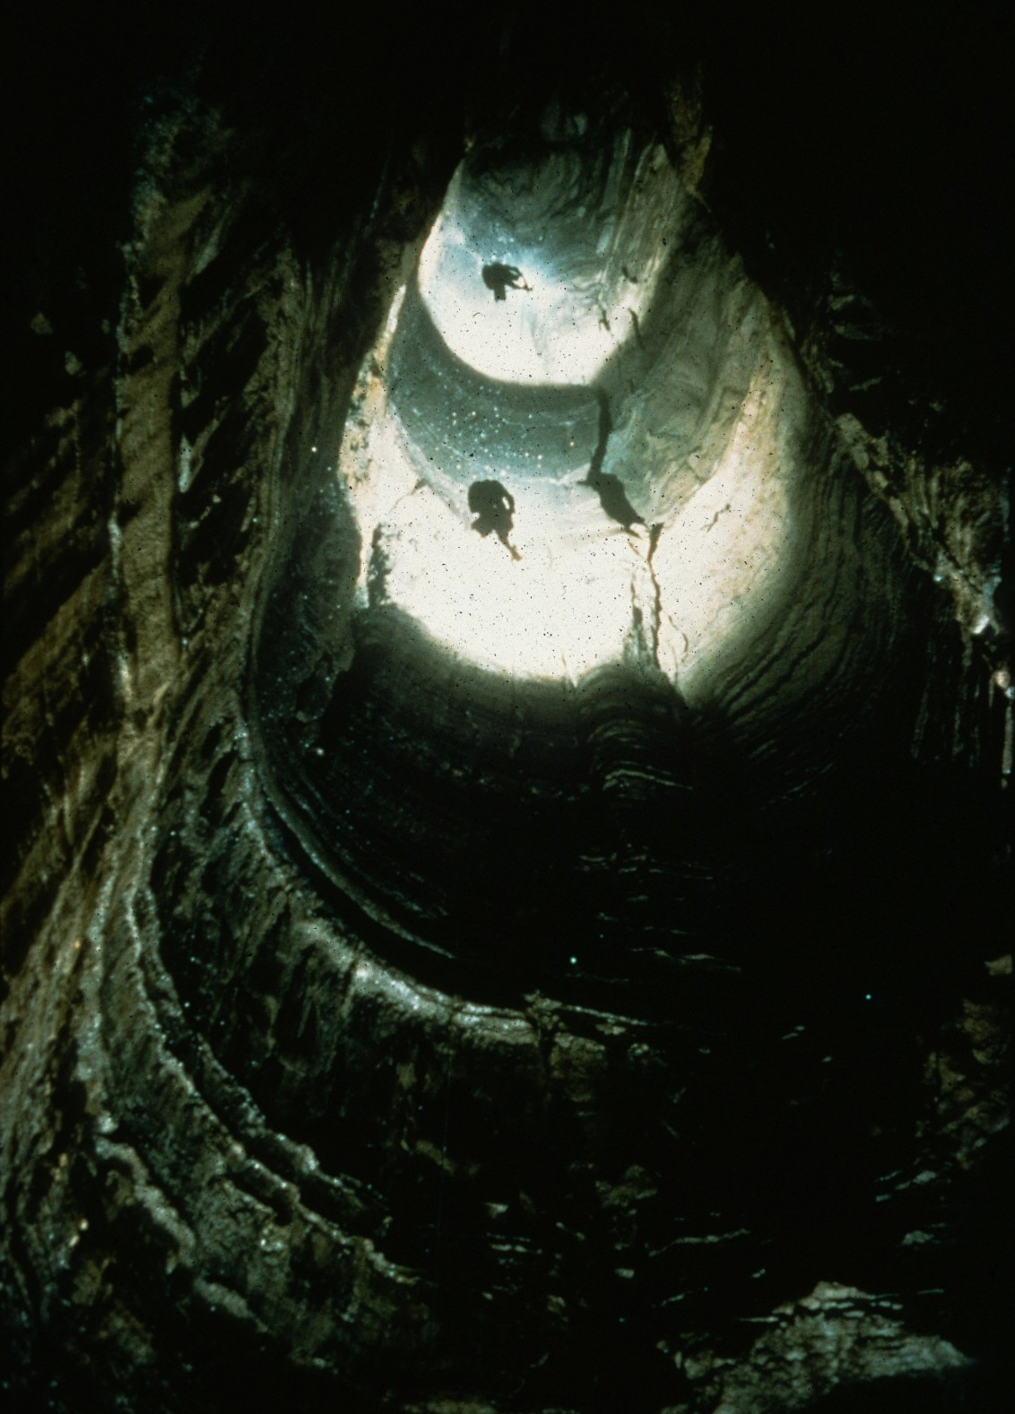
Notes:
Imaginary Well – John Van Swearingen, IV

Slide 7
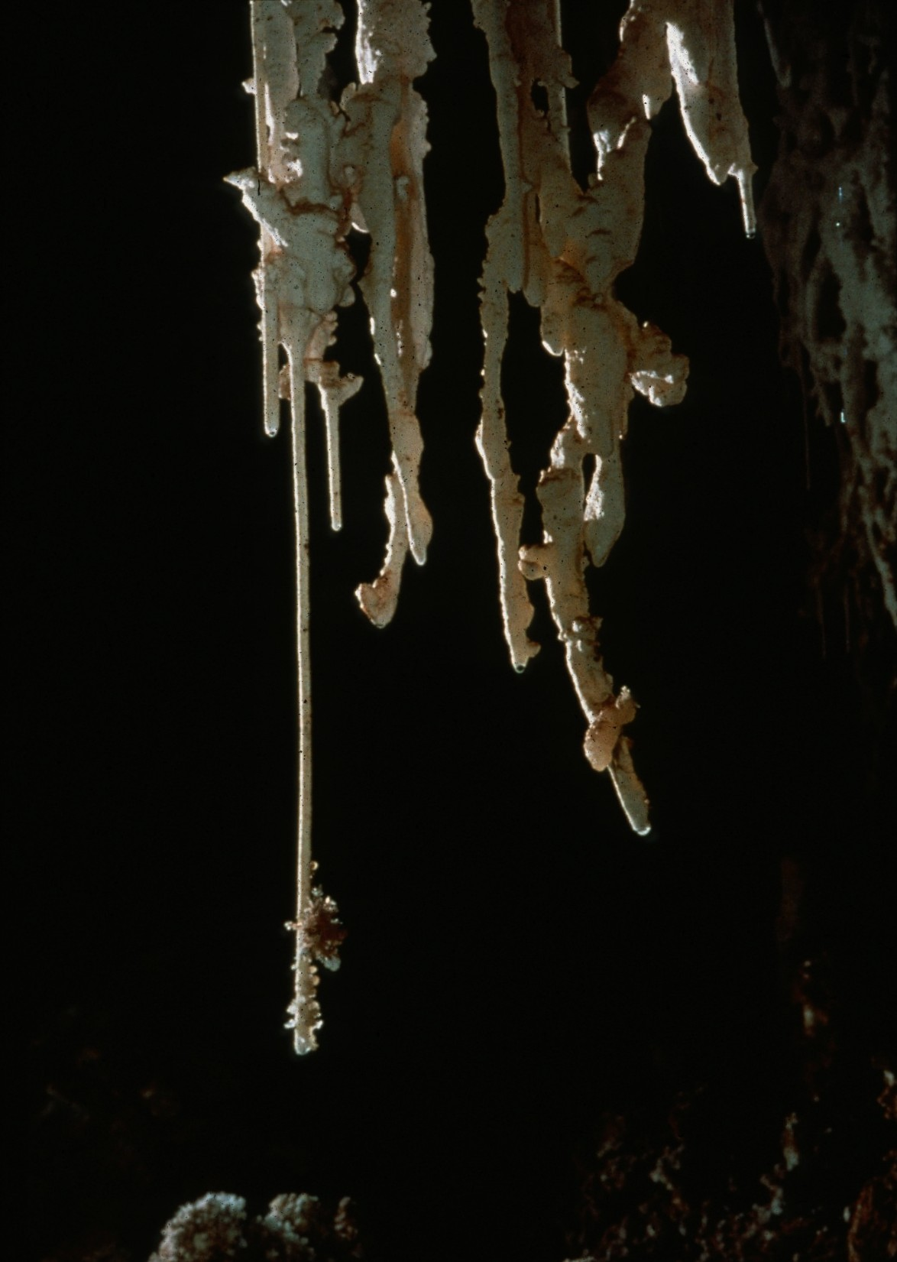
Notes:
Water Works – Peter and Ann Bosted

Slide 8
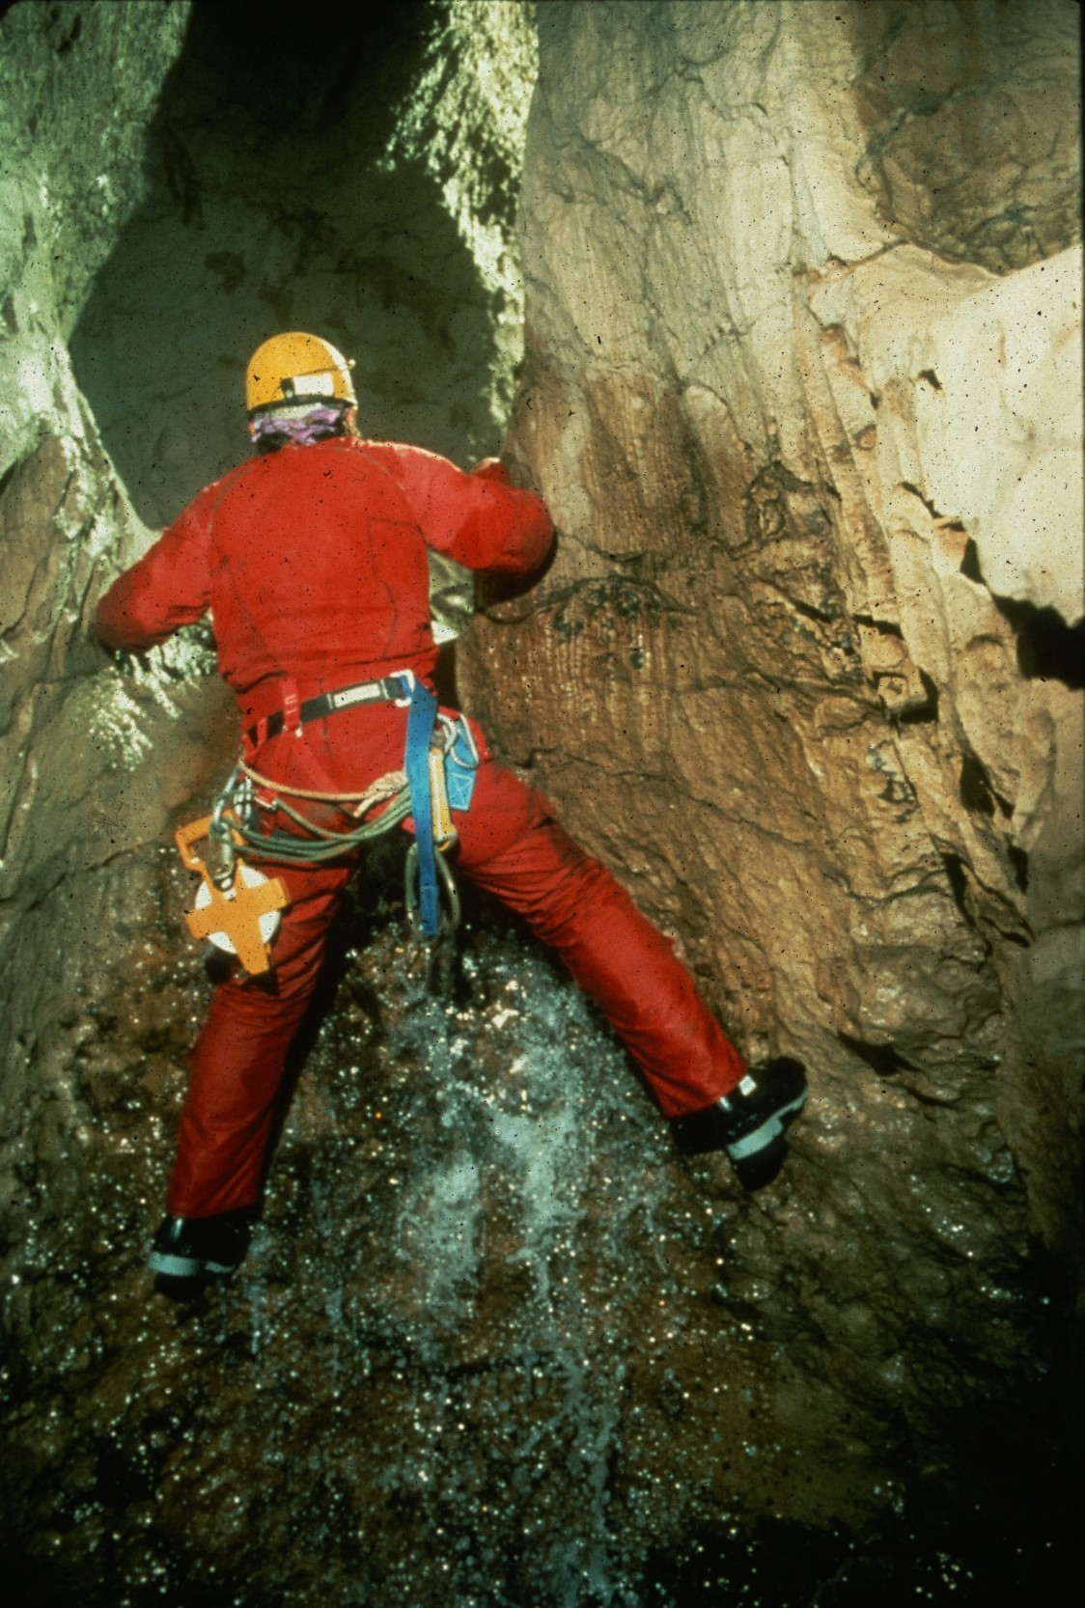
Notes:
Good Form – Dave Bunnell

Slide 9
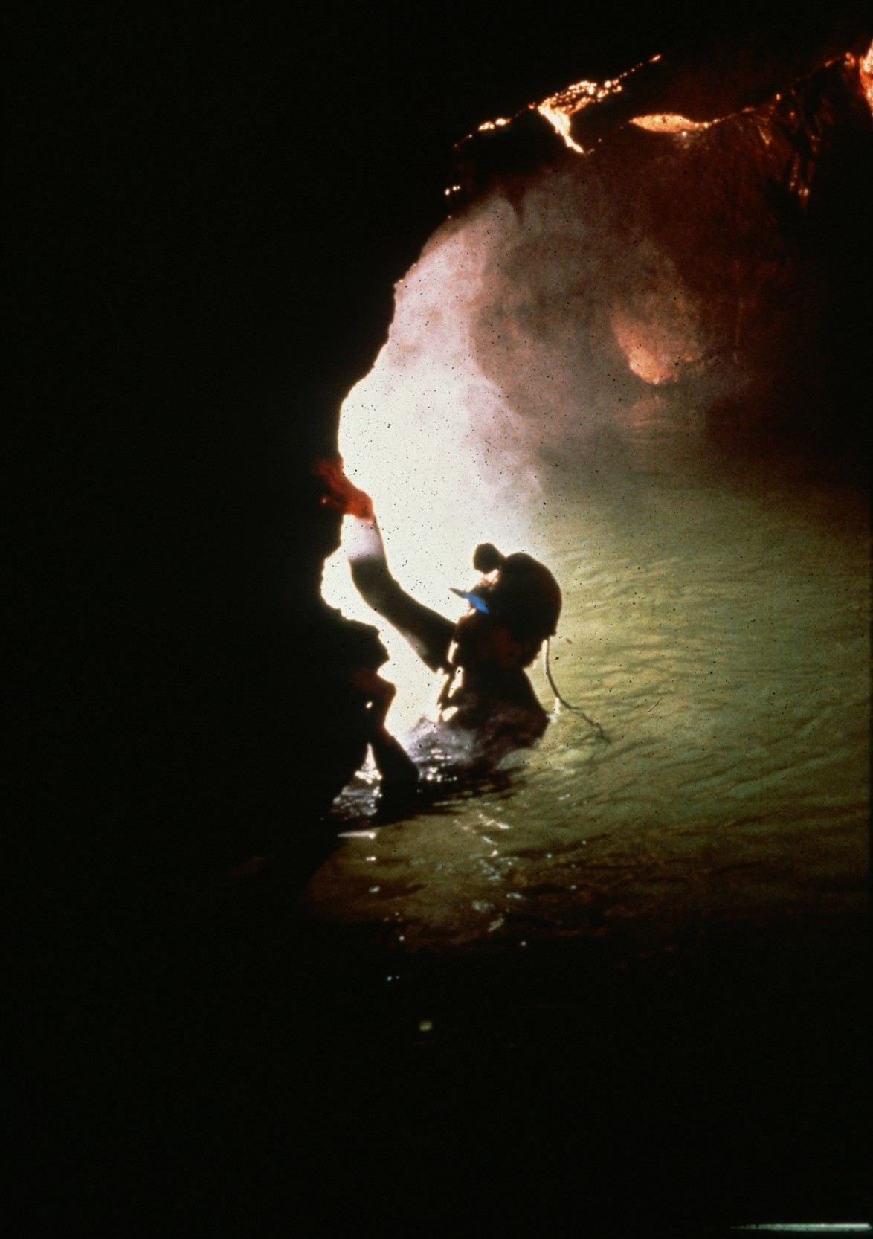
Notes:
Peter Bolt Ogof Llygad, Llwchwr – Chris Howes

Slide 10
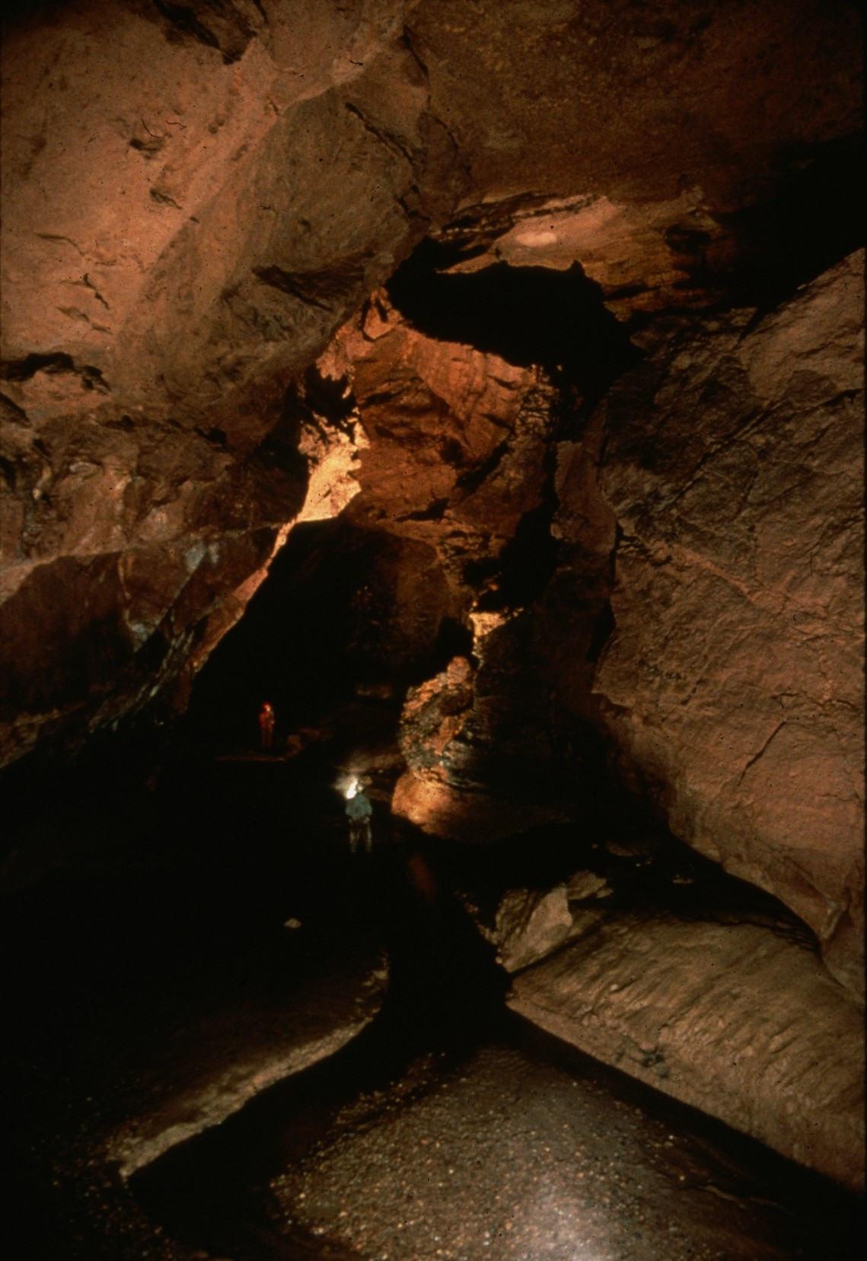
Notes:
Mystic River – Ed McCarthy and Carl Samples

Slide 11
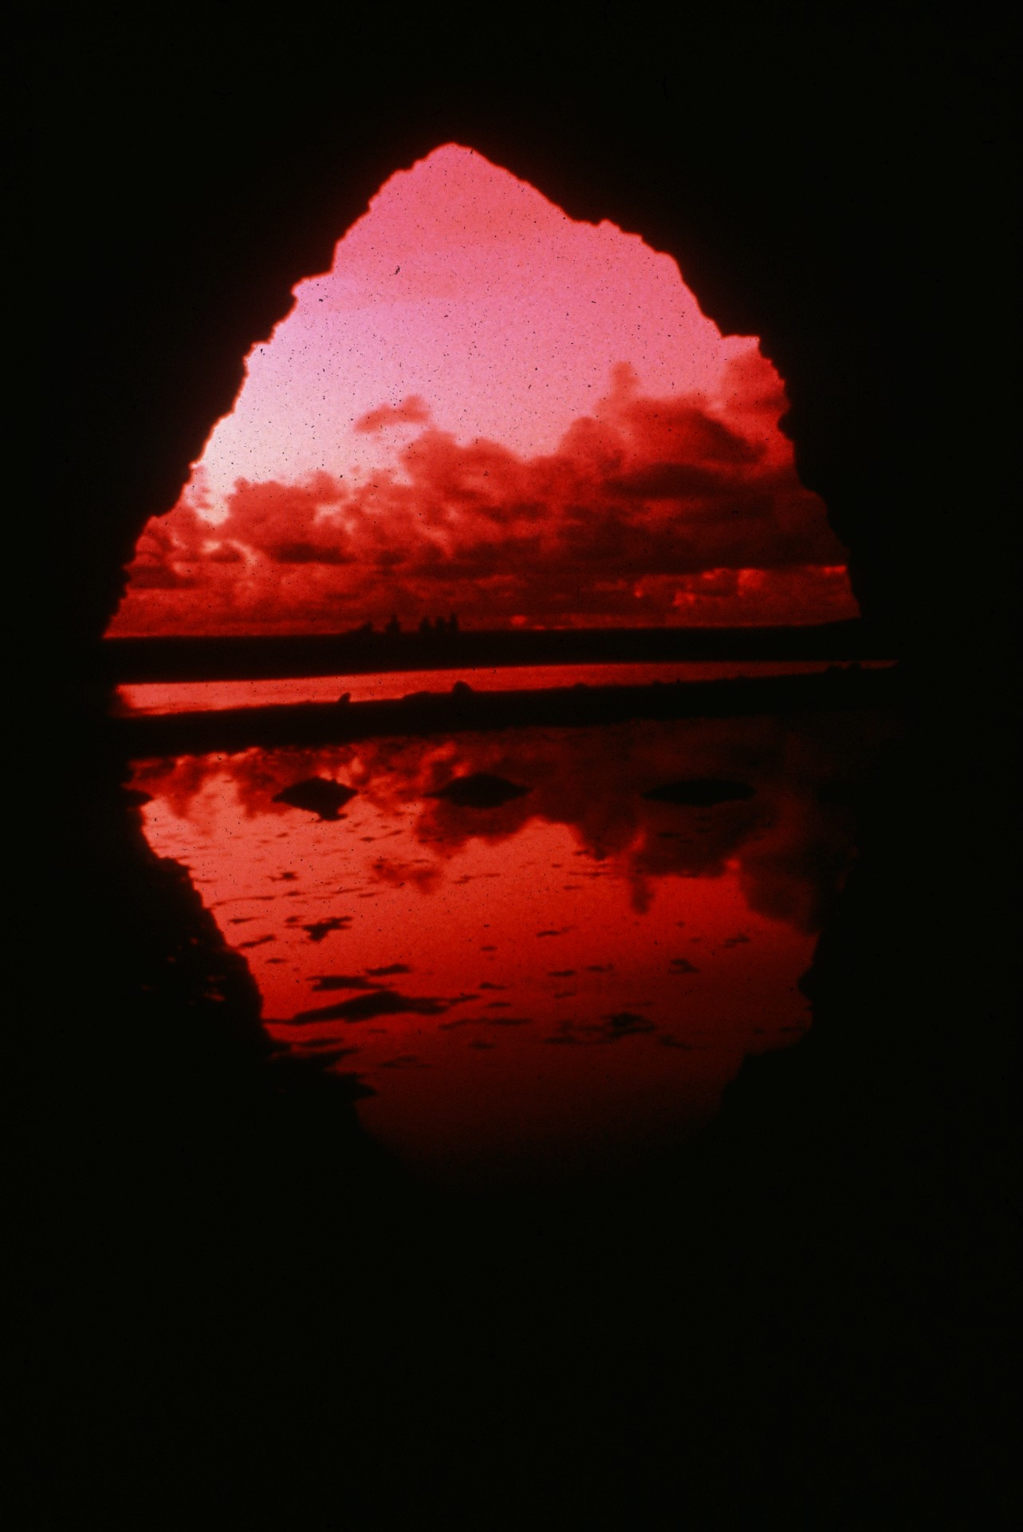
Notes:
Pinatubo Sunset – Djuna Bewley

Slide 12
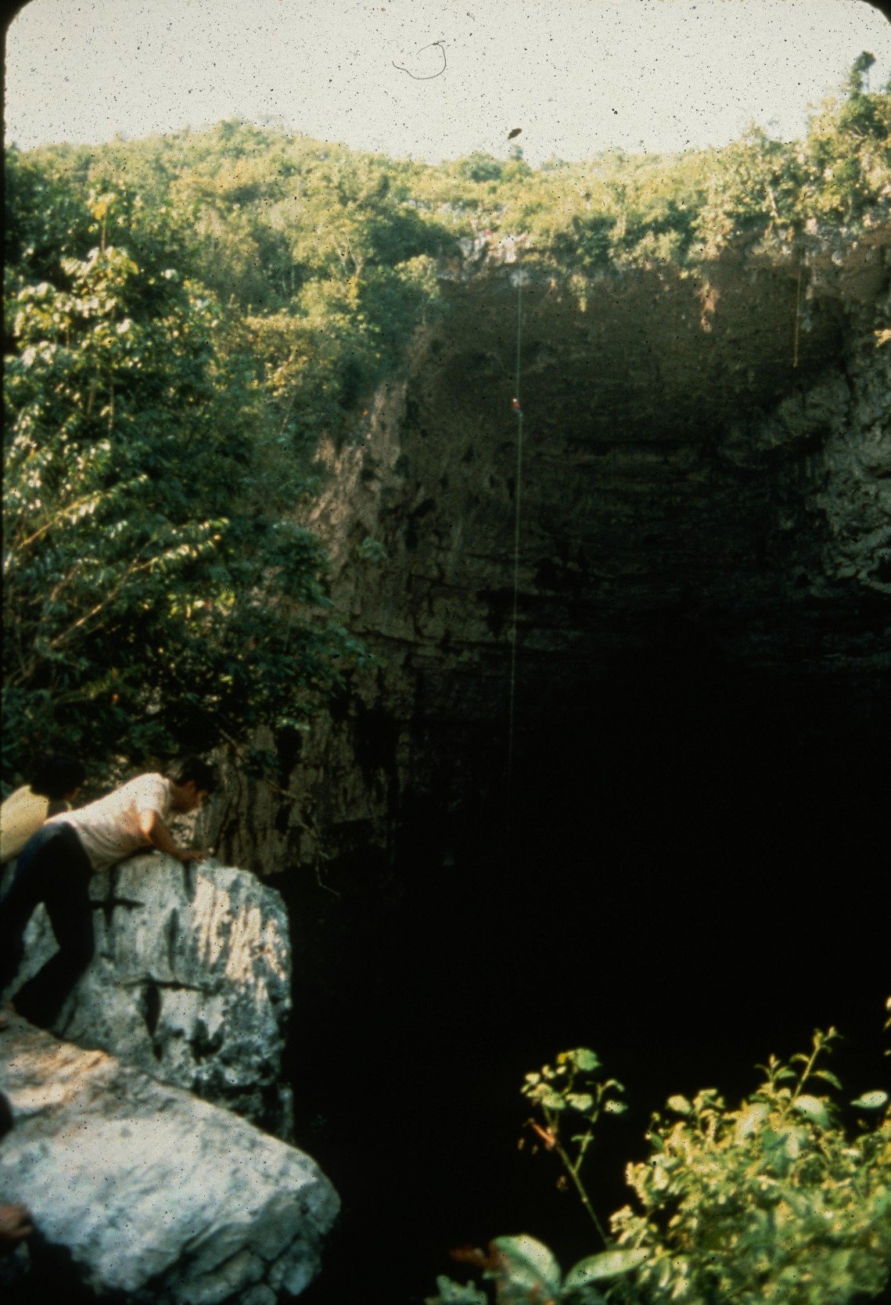
Notes:
Fear and Loathing in Mexico – Jay Jordan

Slide 13
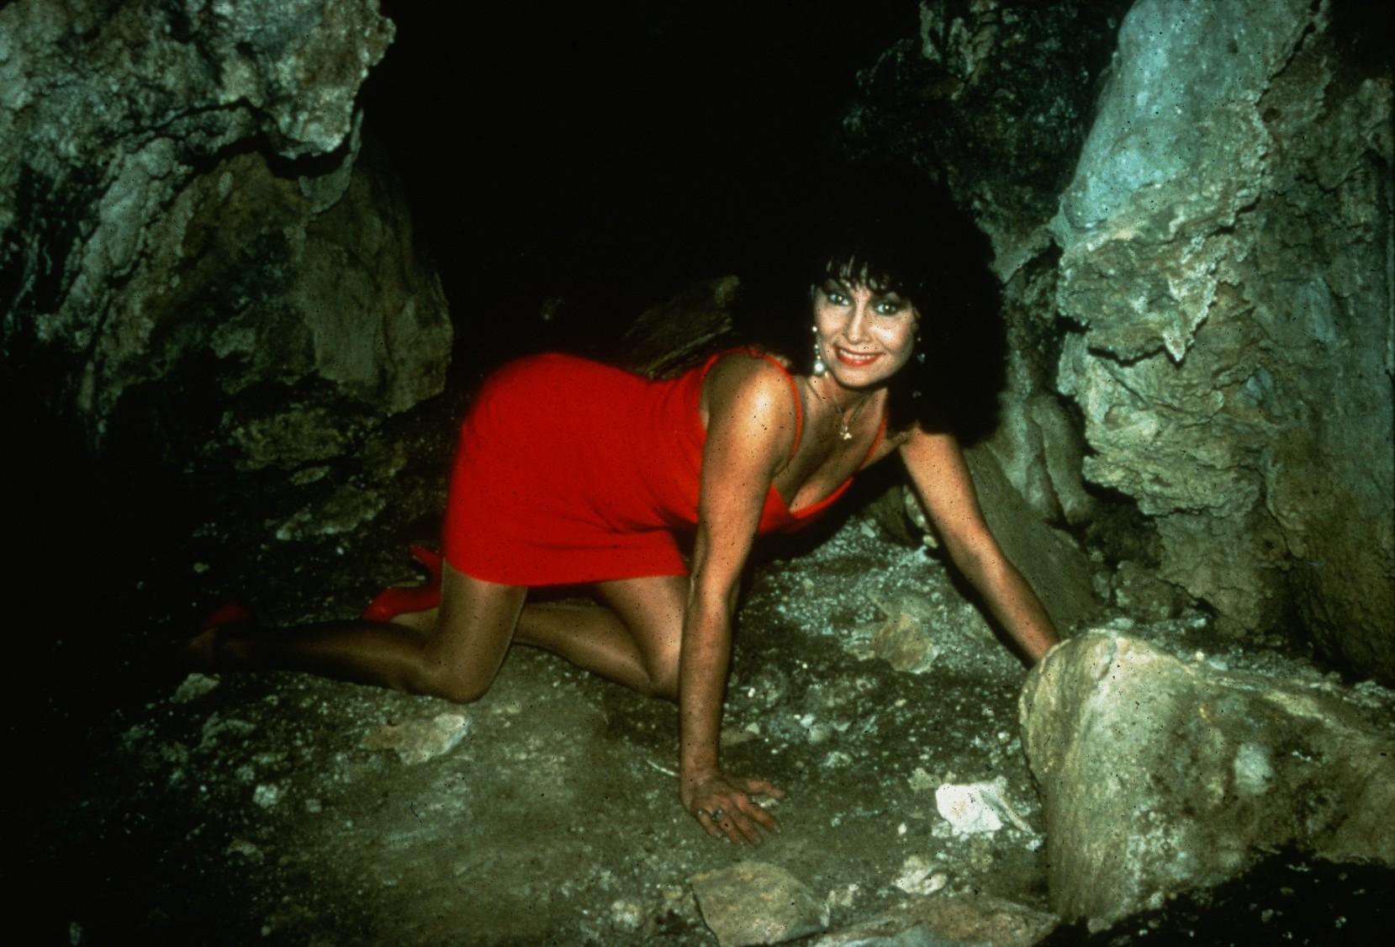
Notes:
With Sheer Energy I Can Crawl Forever – John Van Swearingen, IV

Slide 14
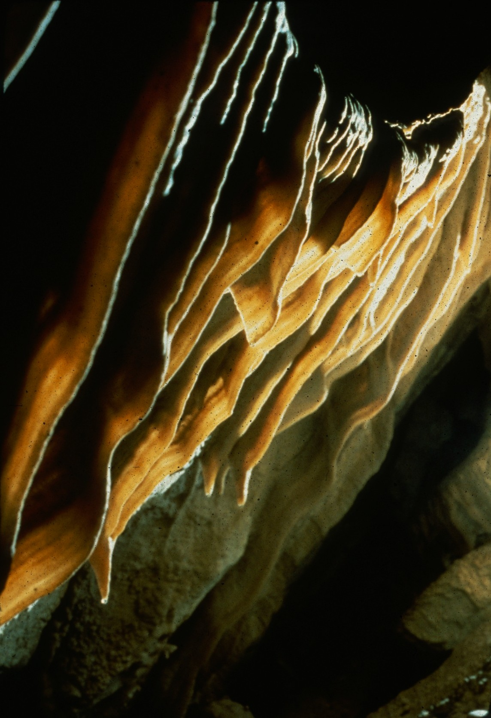
Notes:
Bacon Strips – Charles Anderson

Slide 15
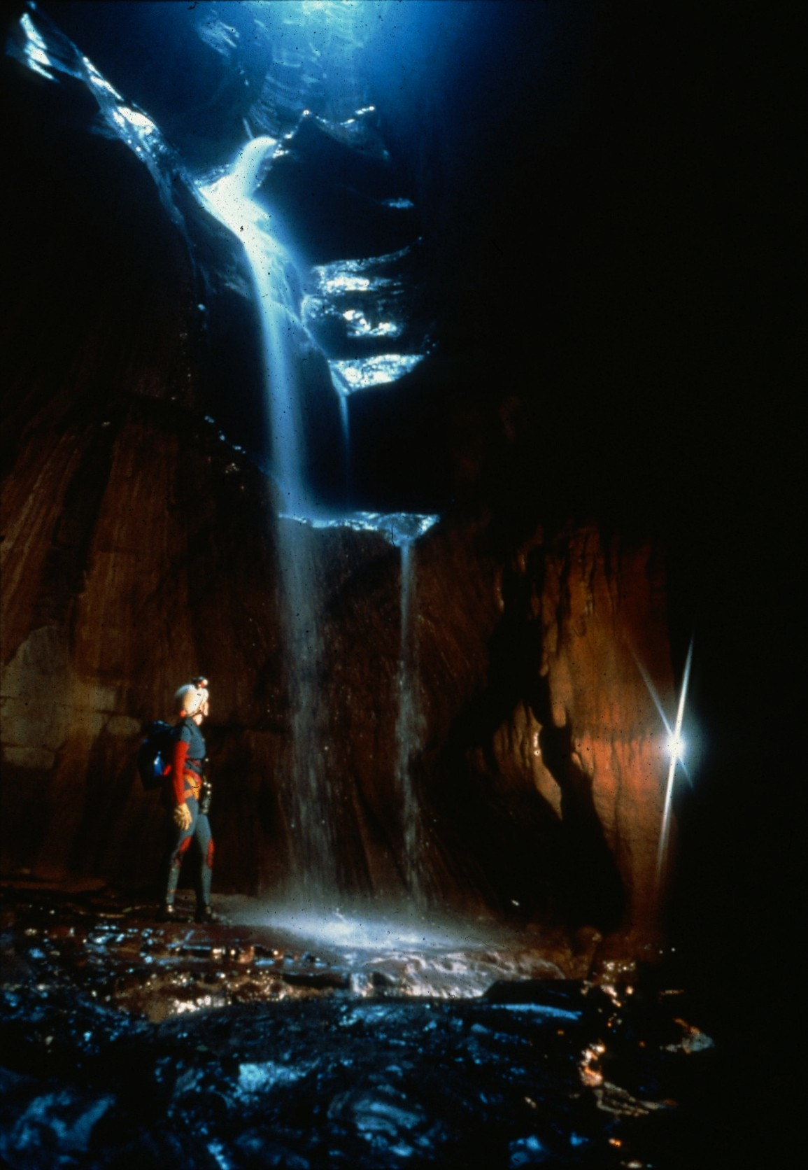
Notes:
Twilight Cascade – Dave Bunnell

Slide 16
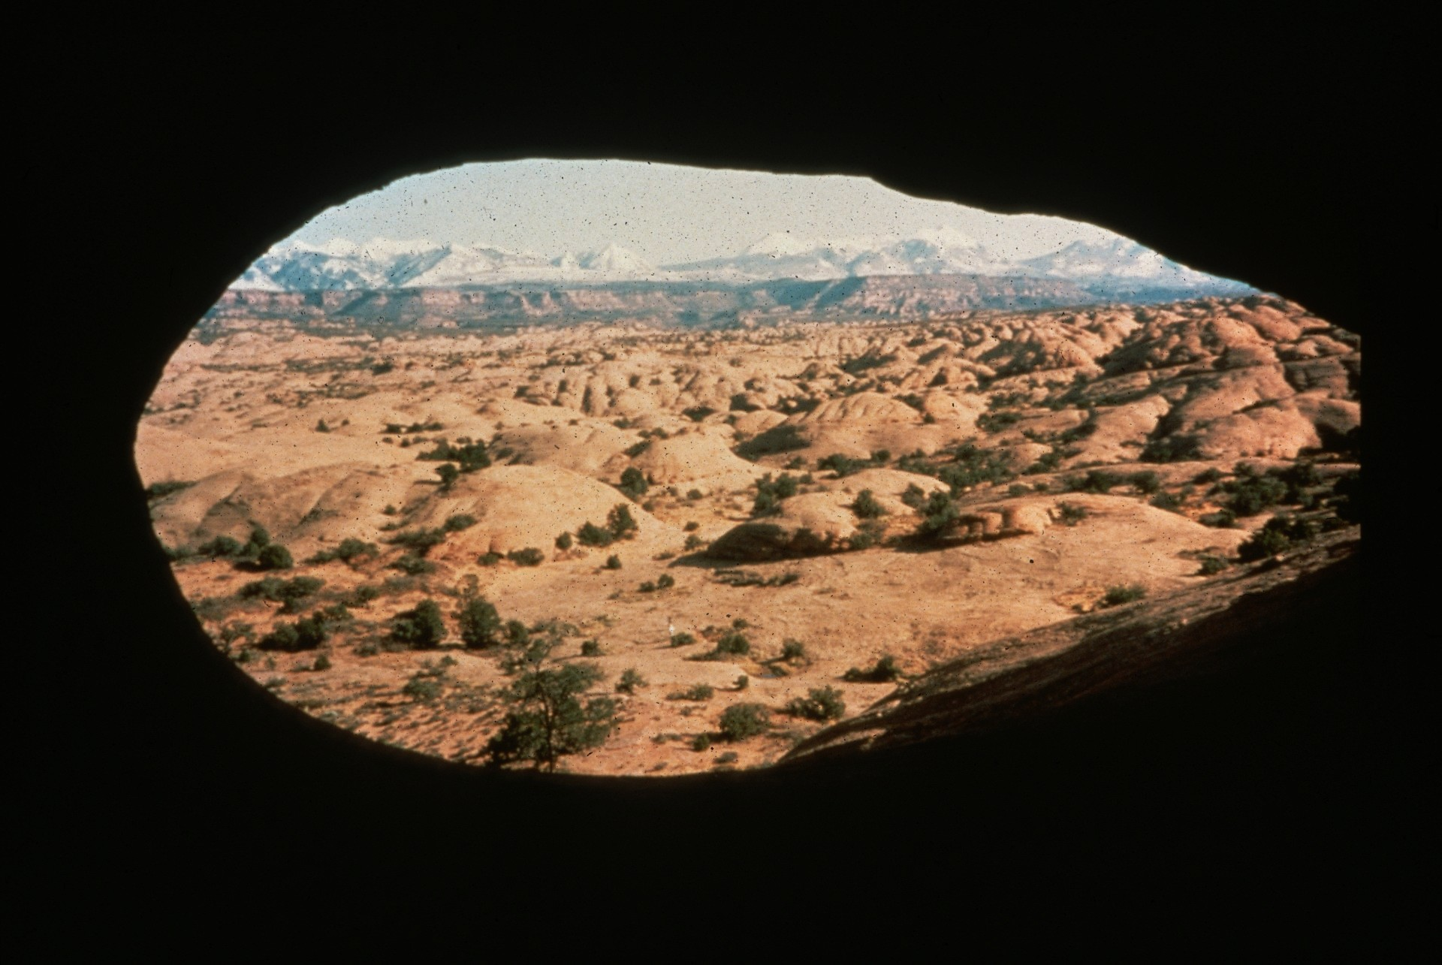
Notes:
Mountain View Cave – Richard Chiasson

Slide 17
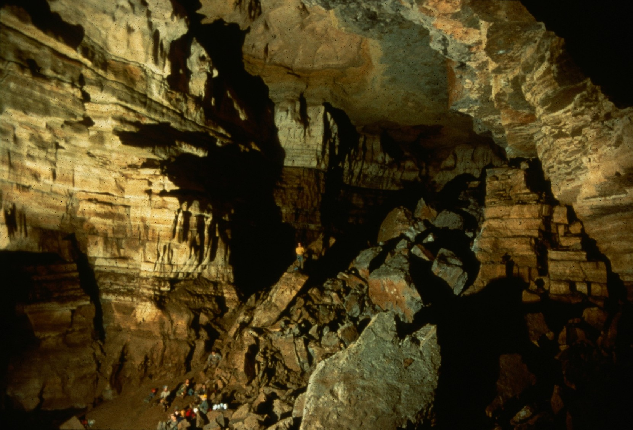
Notes:
Springs Cave, TN – Ken Oeser

Slide 18
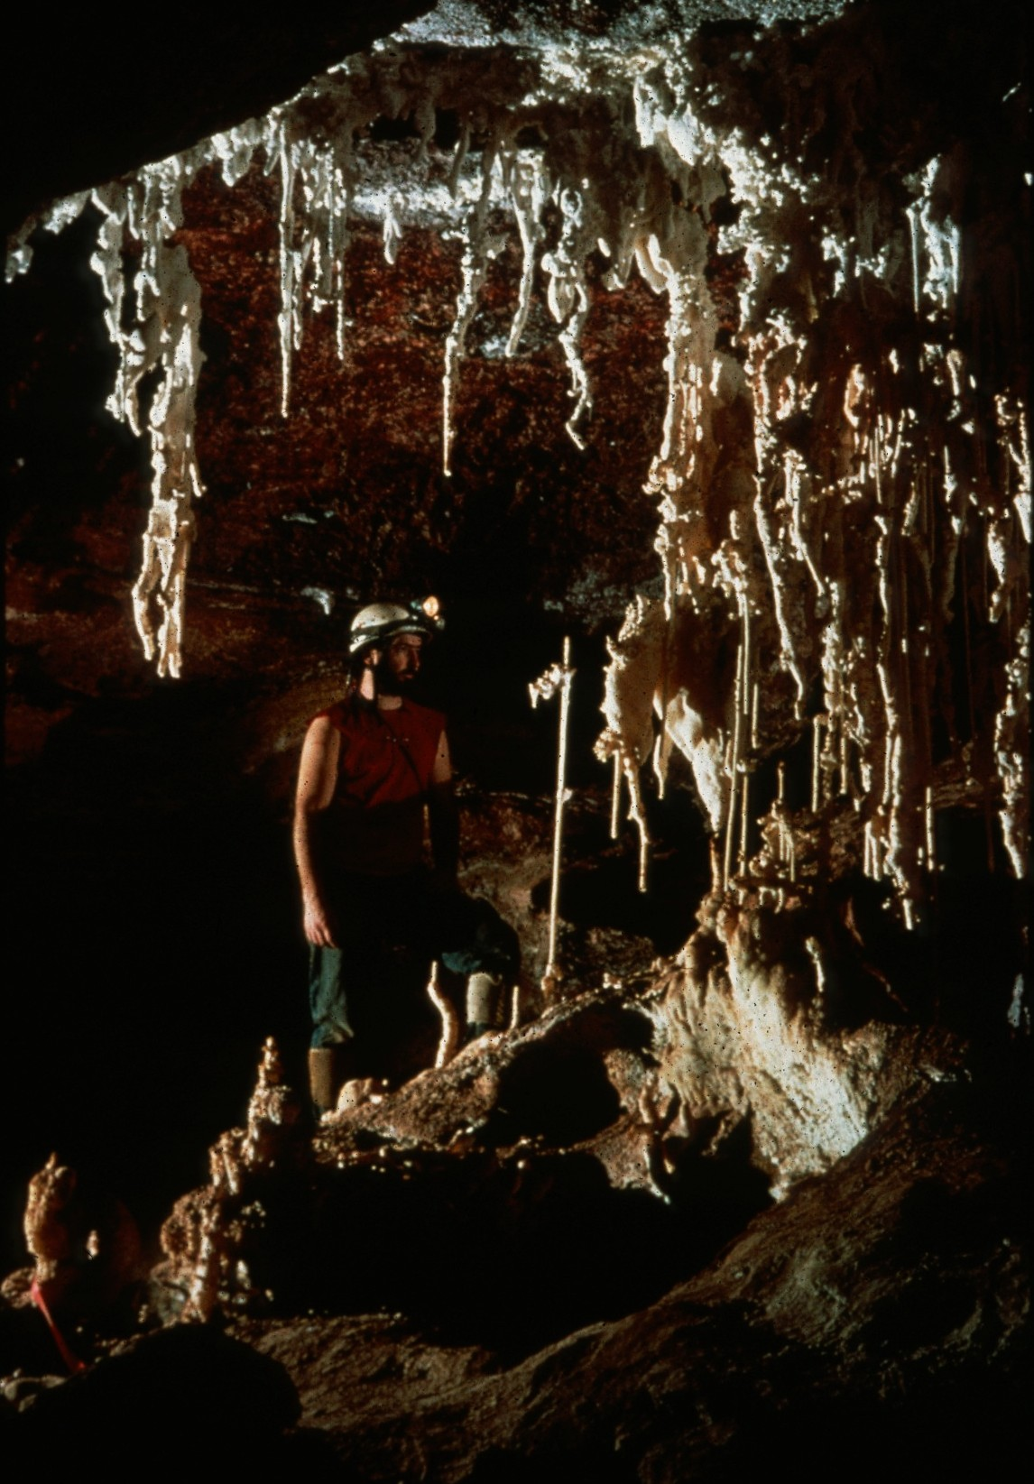
Notes:
Decorated To the Tilt – Peter and Ann Bosted

Slide 19
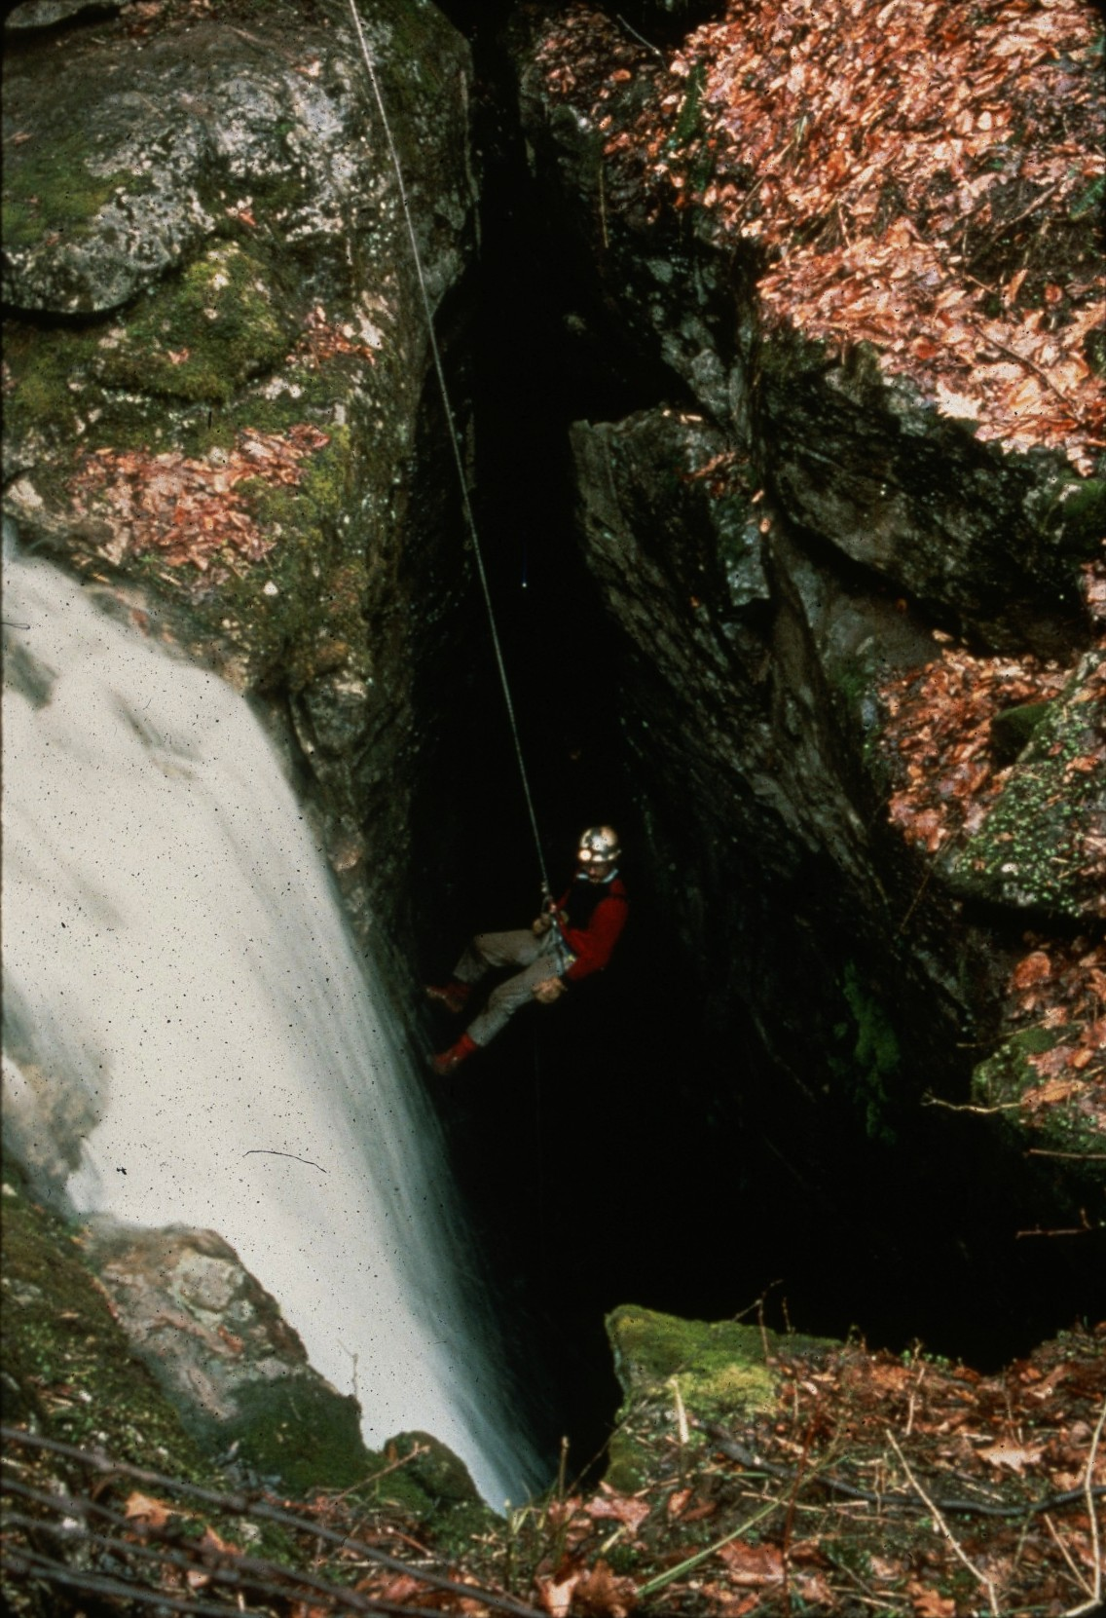
Notes:
The Thundering Hole – Ed McCarthy and Carl Samples

Slide 20
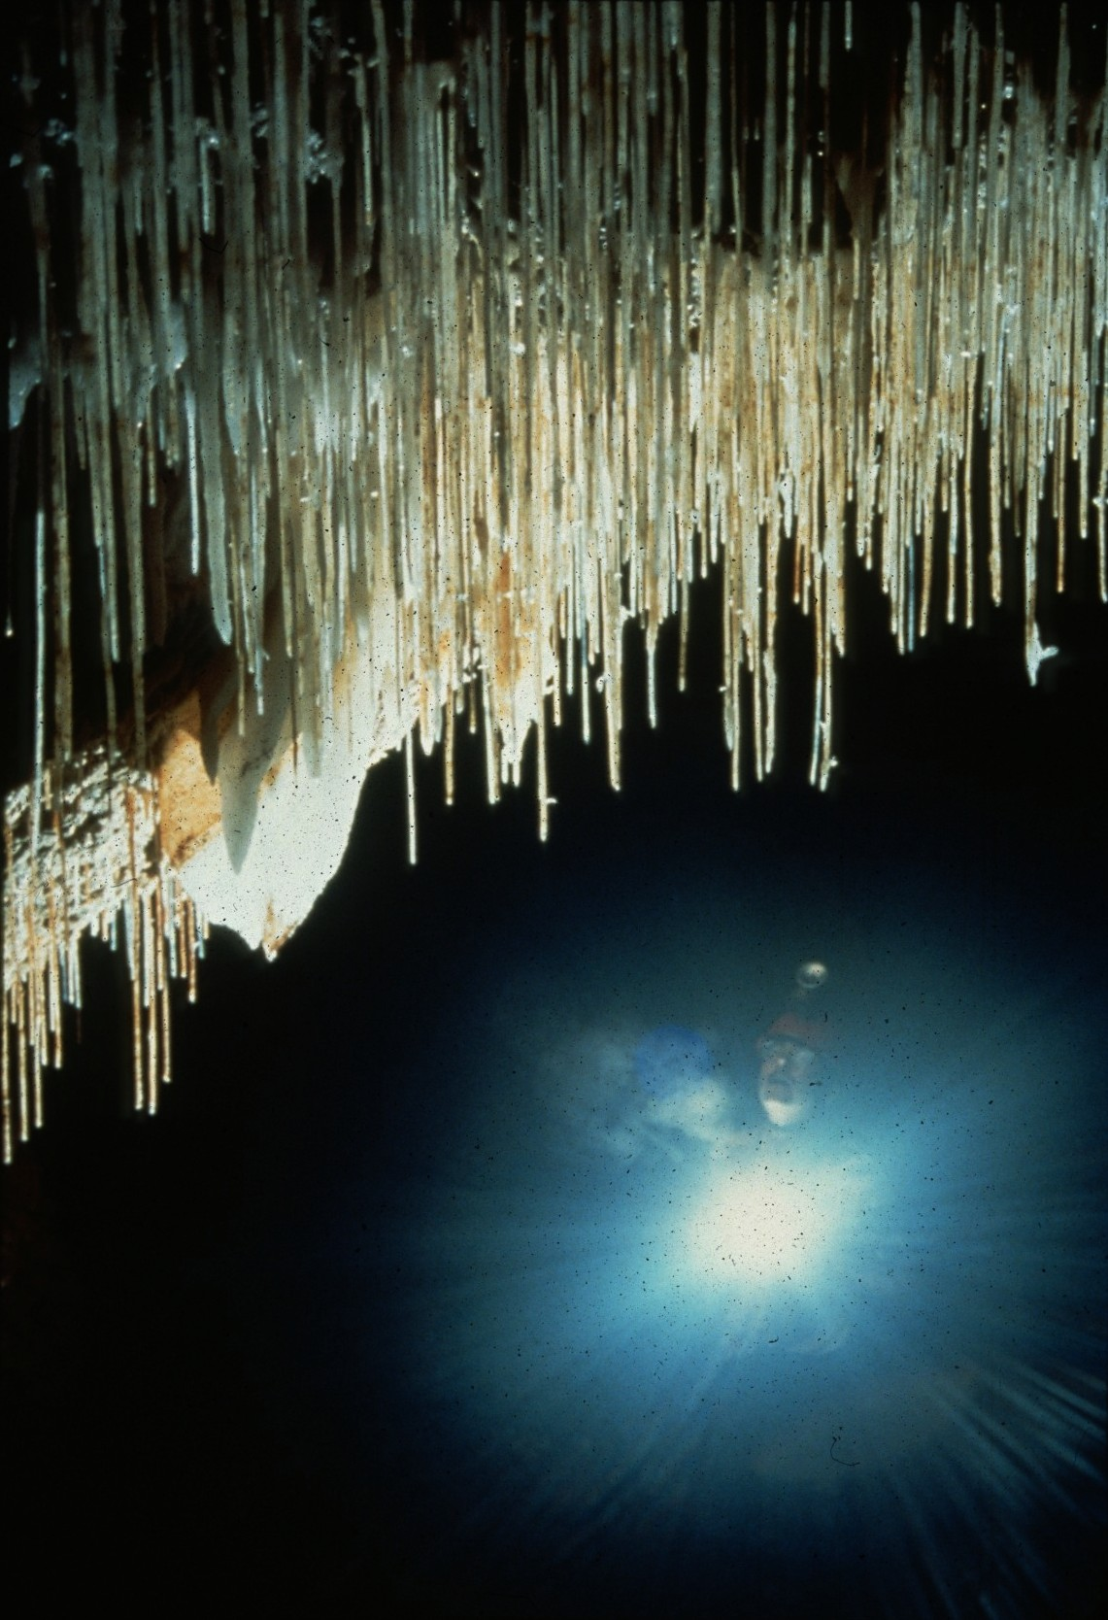
Notes:
Spears From The Ceiling – Al Ogden

Slide 21
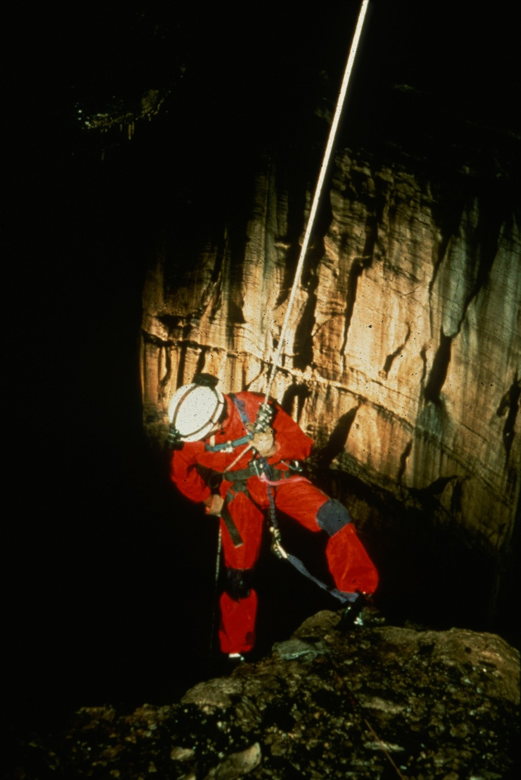
Notes:
The Next Step – John Van Swearingen, IV

Slide 22
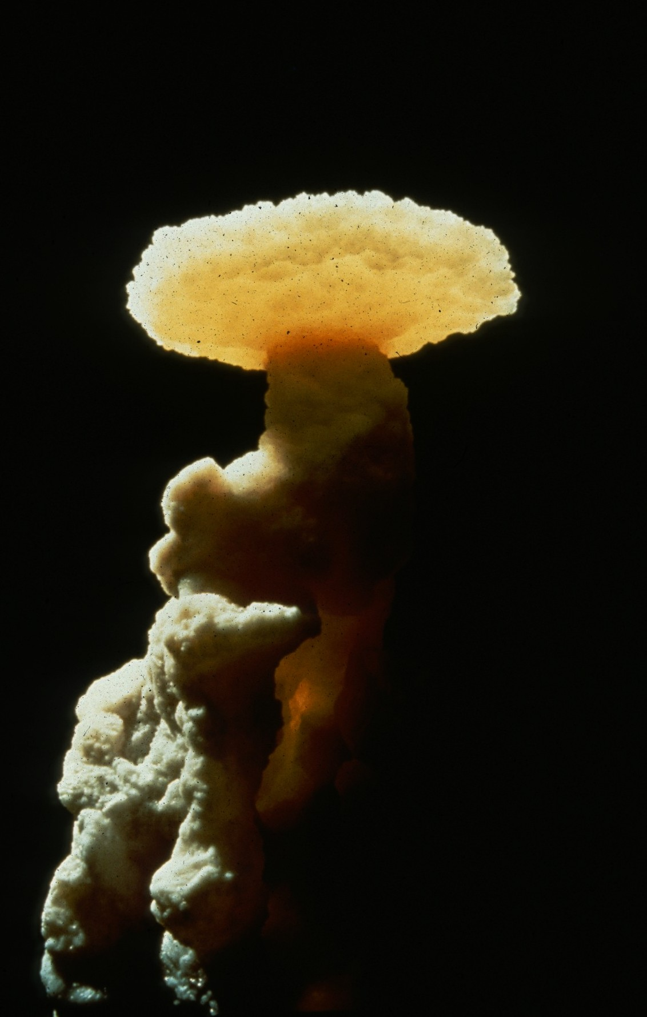
Notes:
Pedestrial – David L. Harris

Slide 23
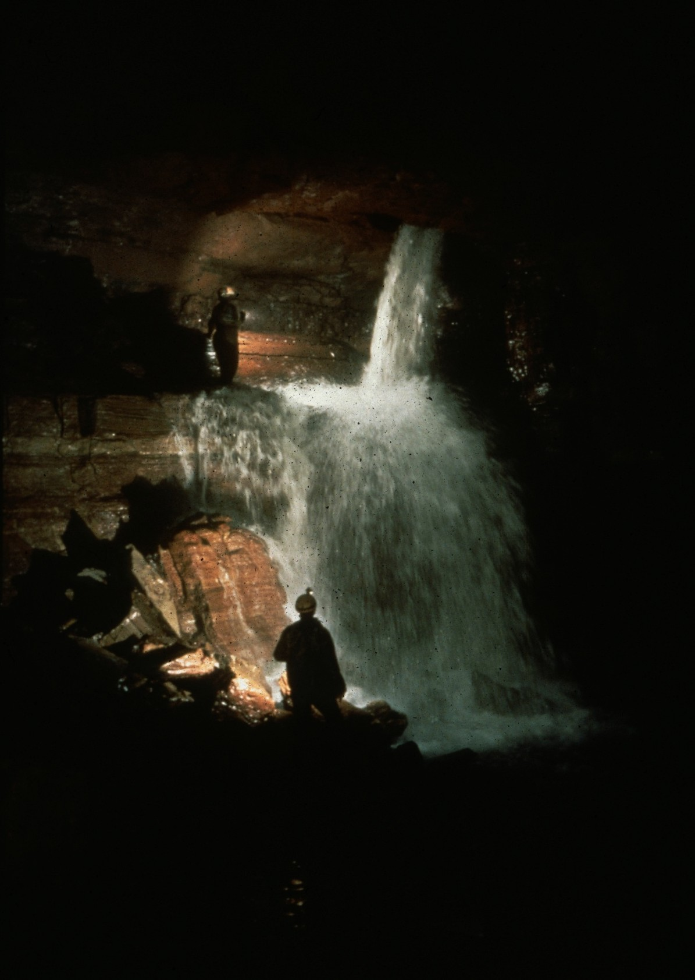
Notes:
Crayfish Pool – Ron Simmons

Slide 24
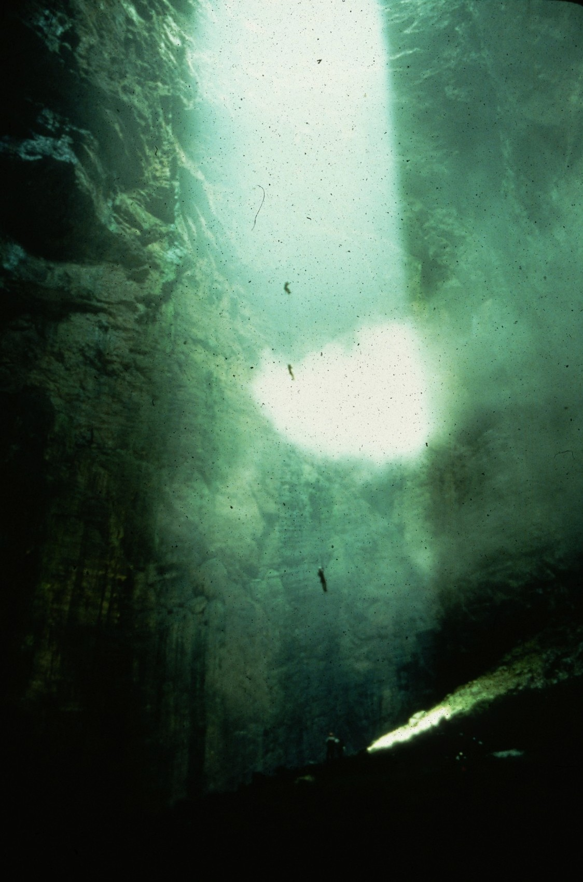
Notes:
Three’s Company – Dave Bunnell

Slide 25
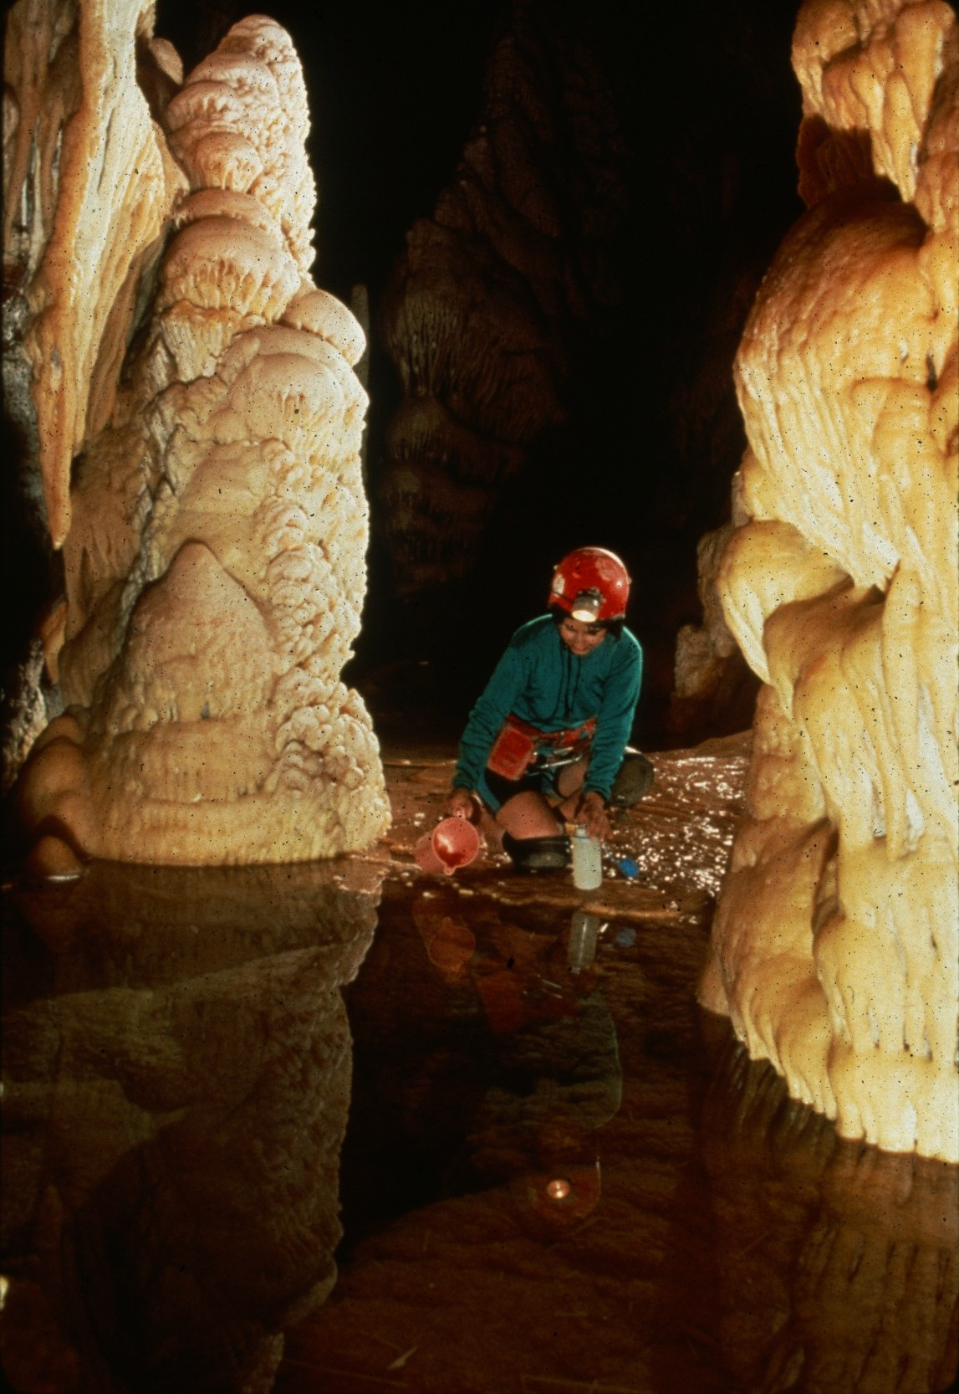
Notes:
In A Cave Of The First Water – Peter and Ann Bosted

Slide 26
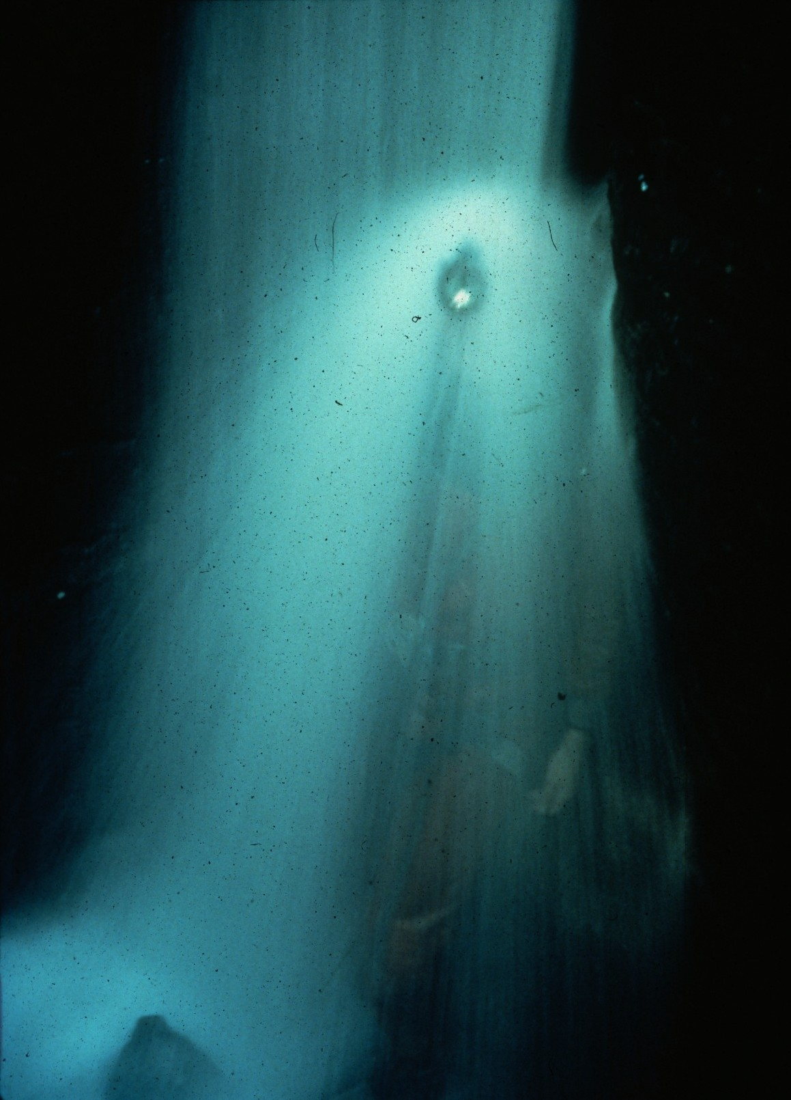
Notes:
Localized Heavy Thunderstorms – John Van Swearingen, IV

Slide 27
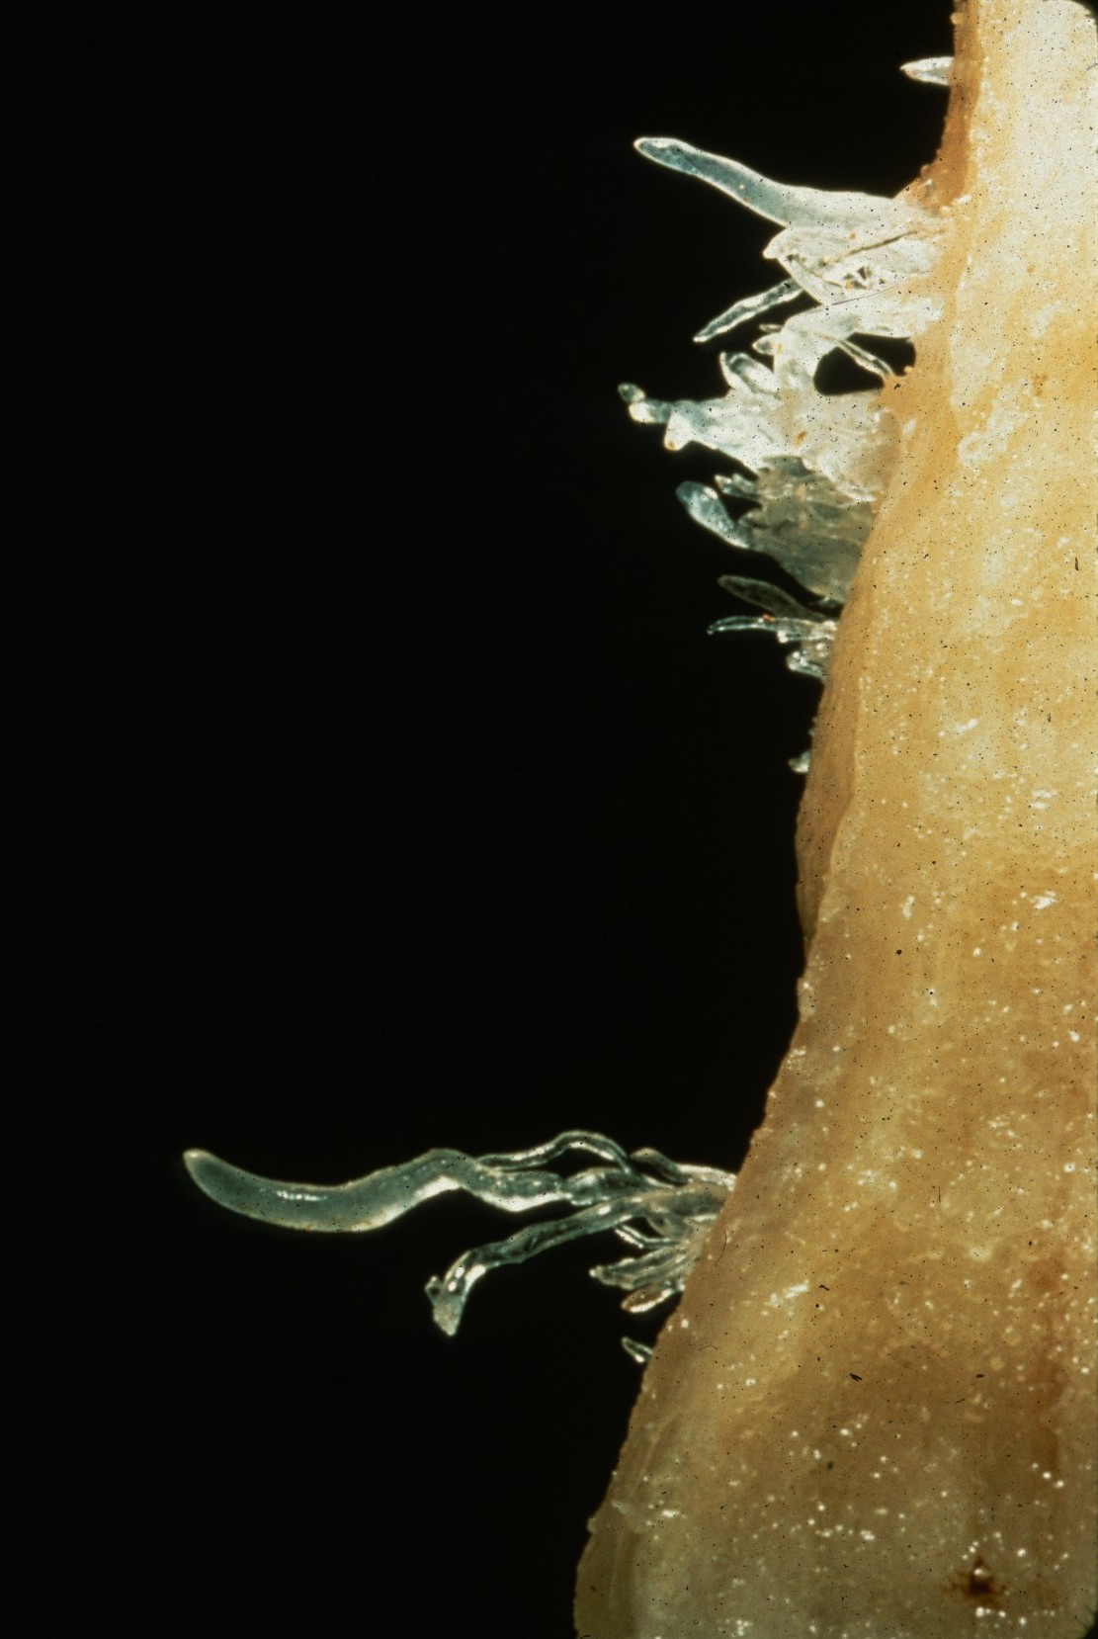
Notes:
Delicacy – Jim Loftin

Slide 28
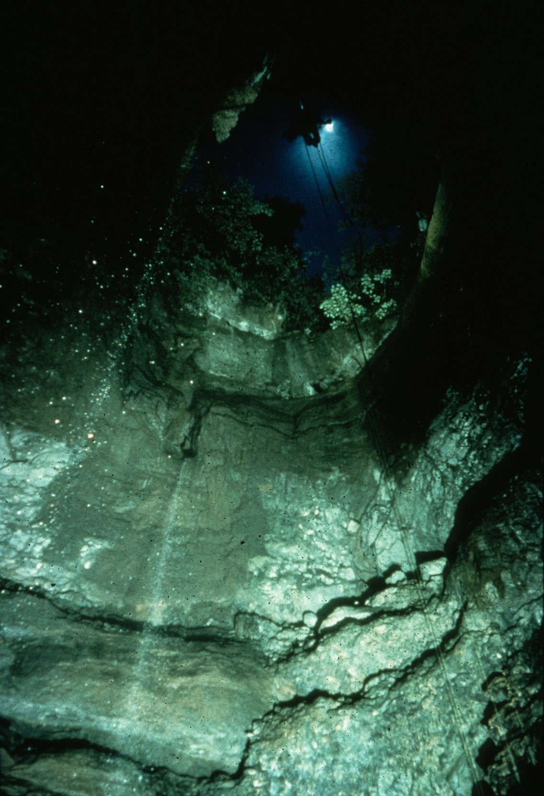
Notes:
Steven’s Gap – John Van Swearingen, IV

Slide 29
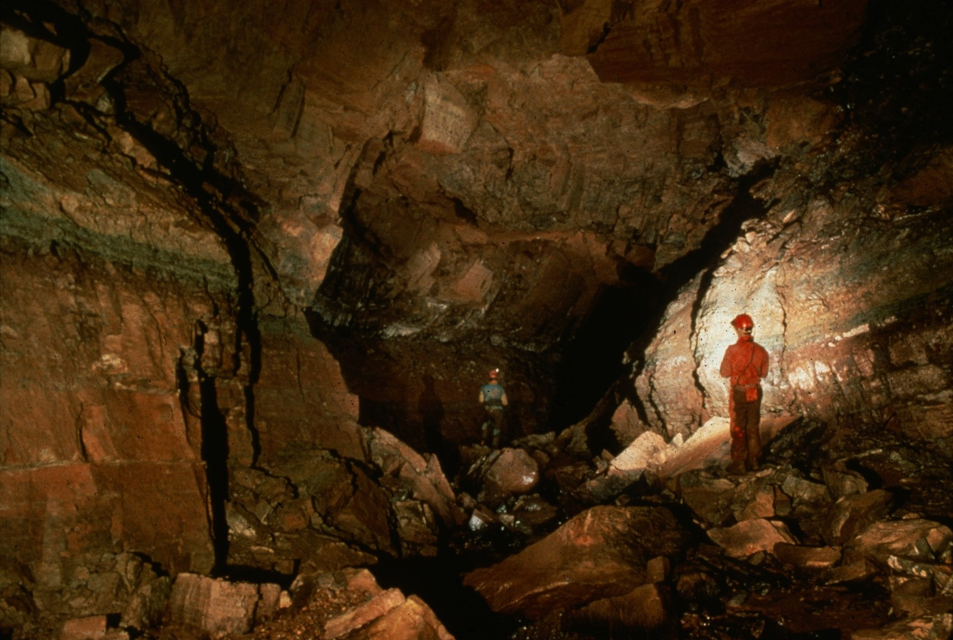
Notes:
Around the Bend – Ed McCarthy and Carl Samples

Slide 30
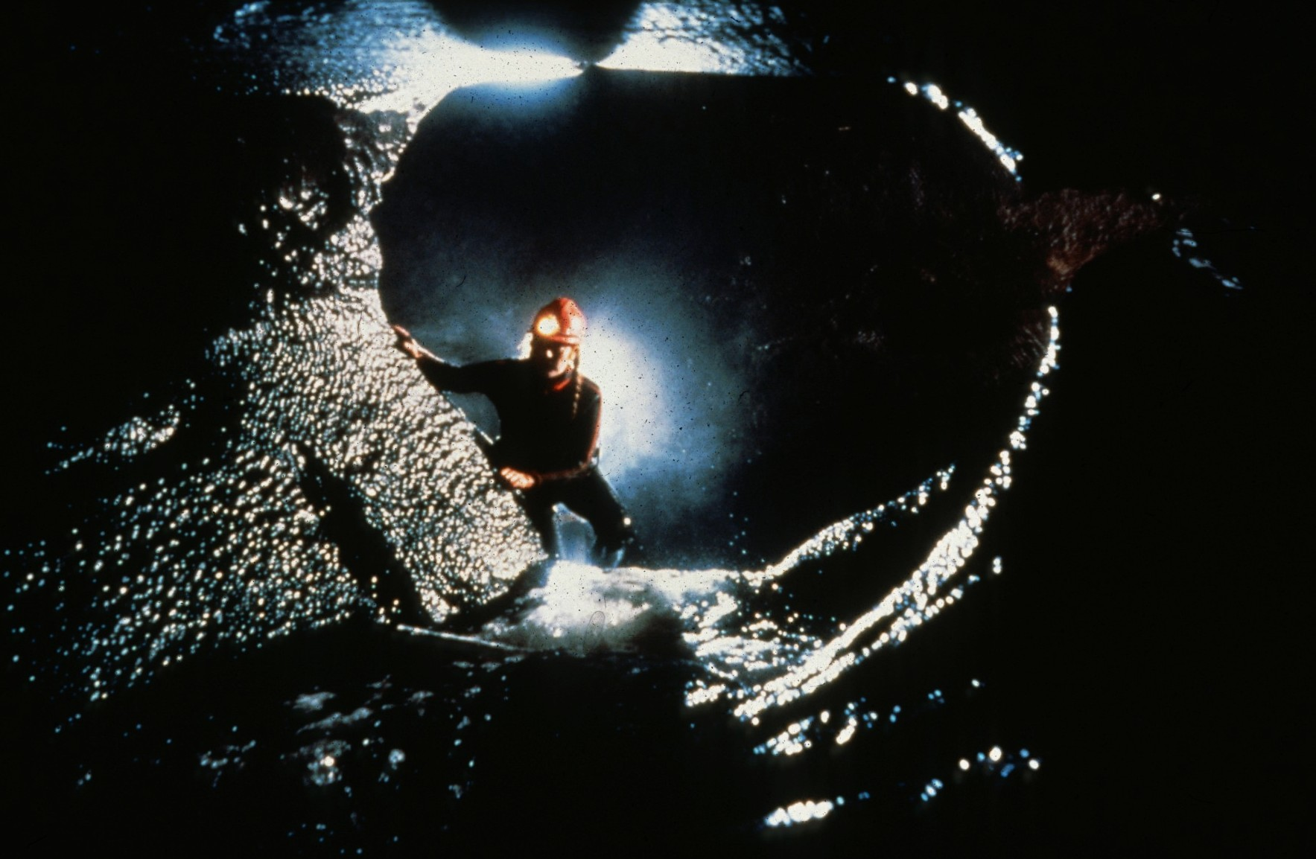
Notes:
Jane Mitchell, Ogof Ffynnon Ddu – Christ Howes

Slide 31
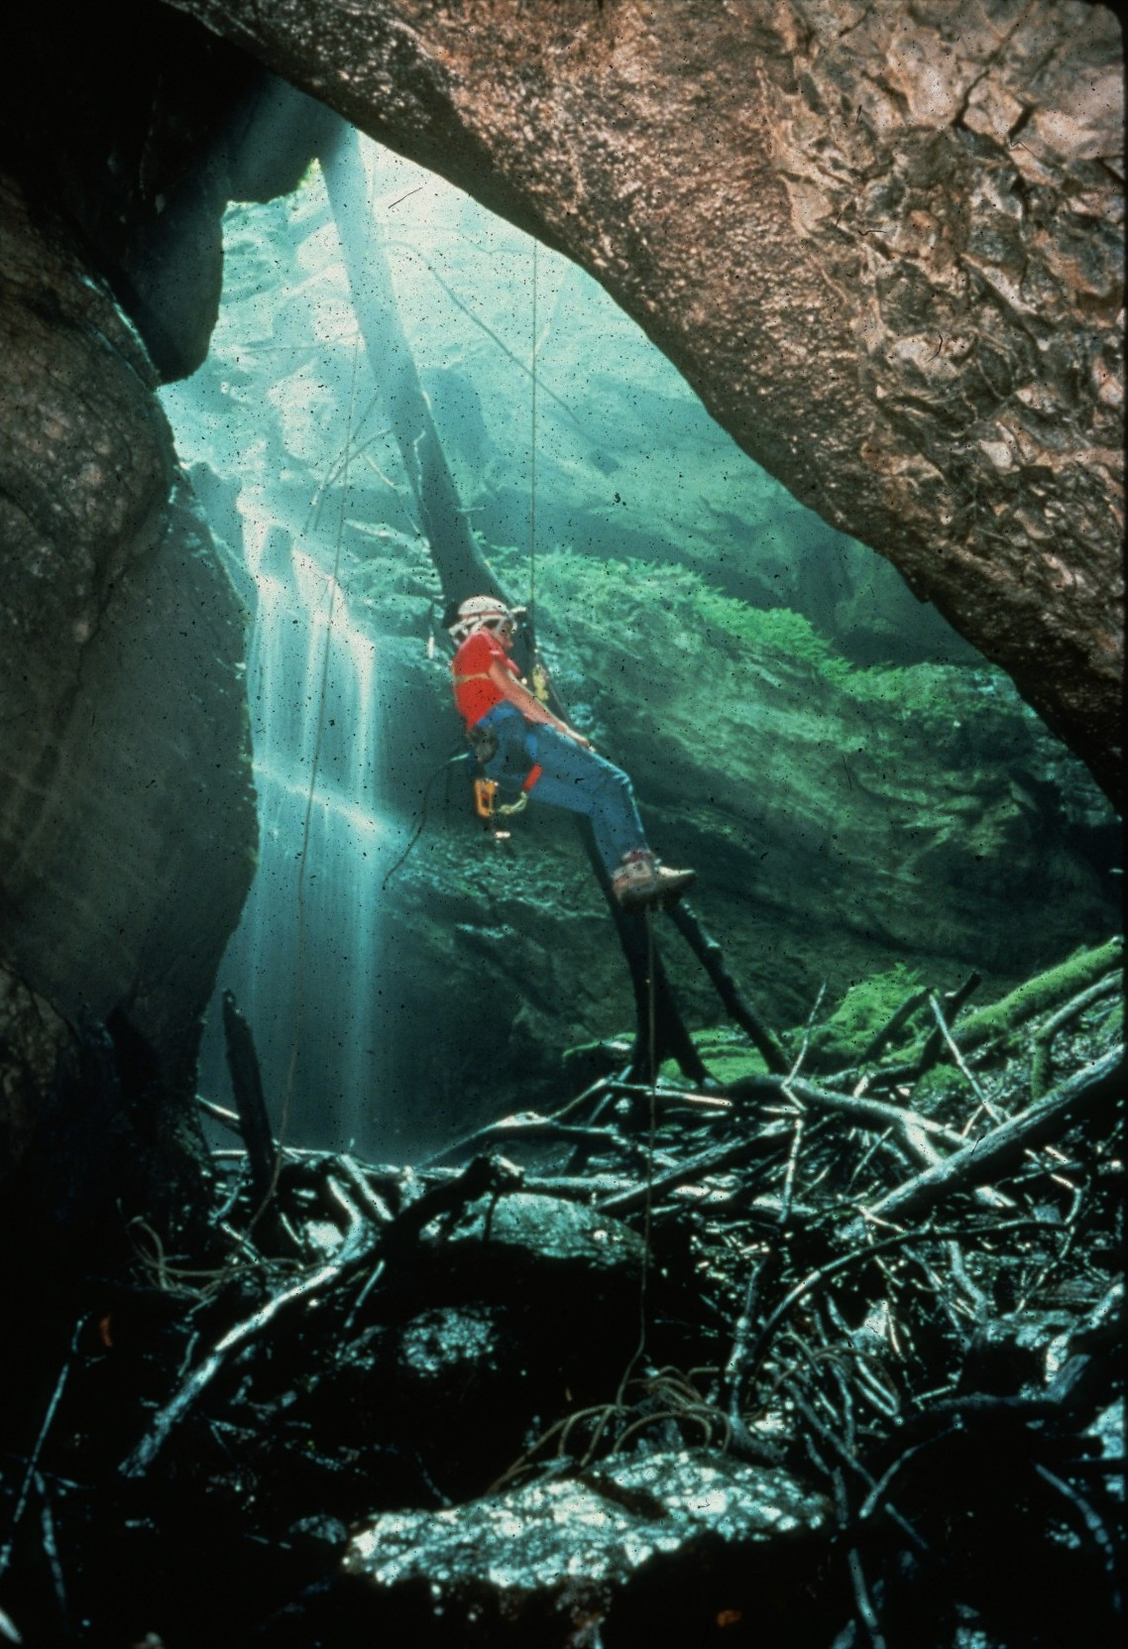
Notes:
Suspended – John Van Swearingen, IV

Slide 32
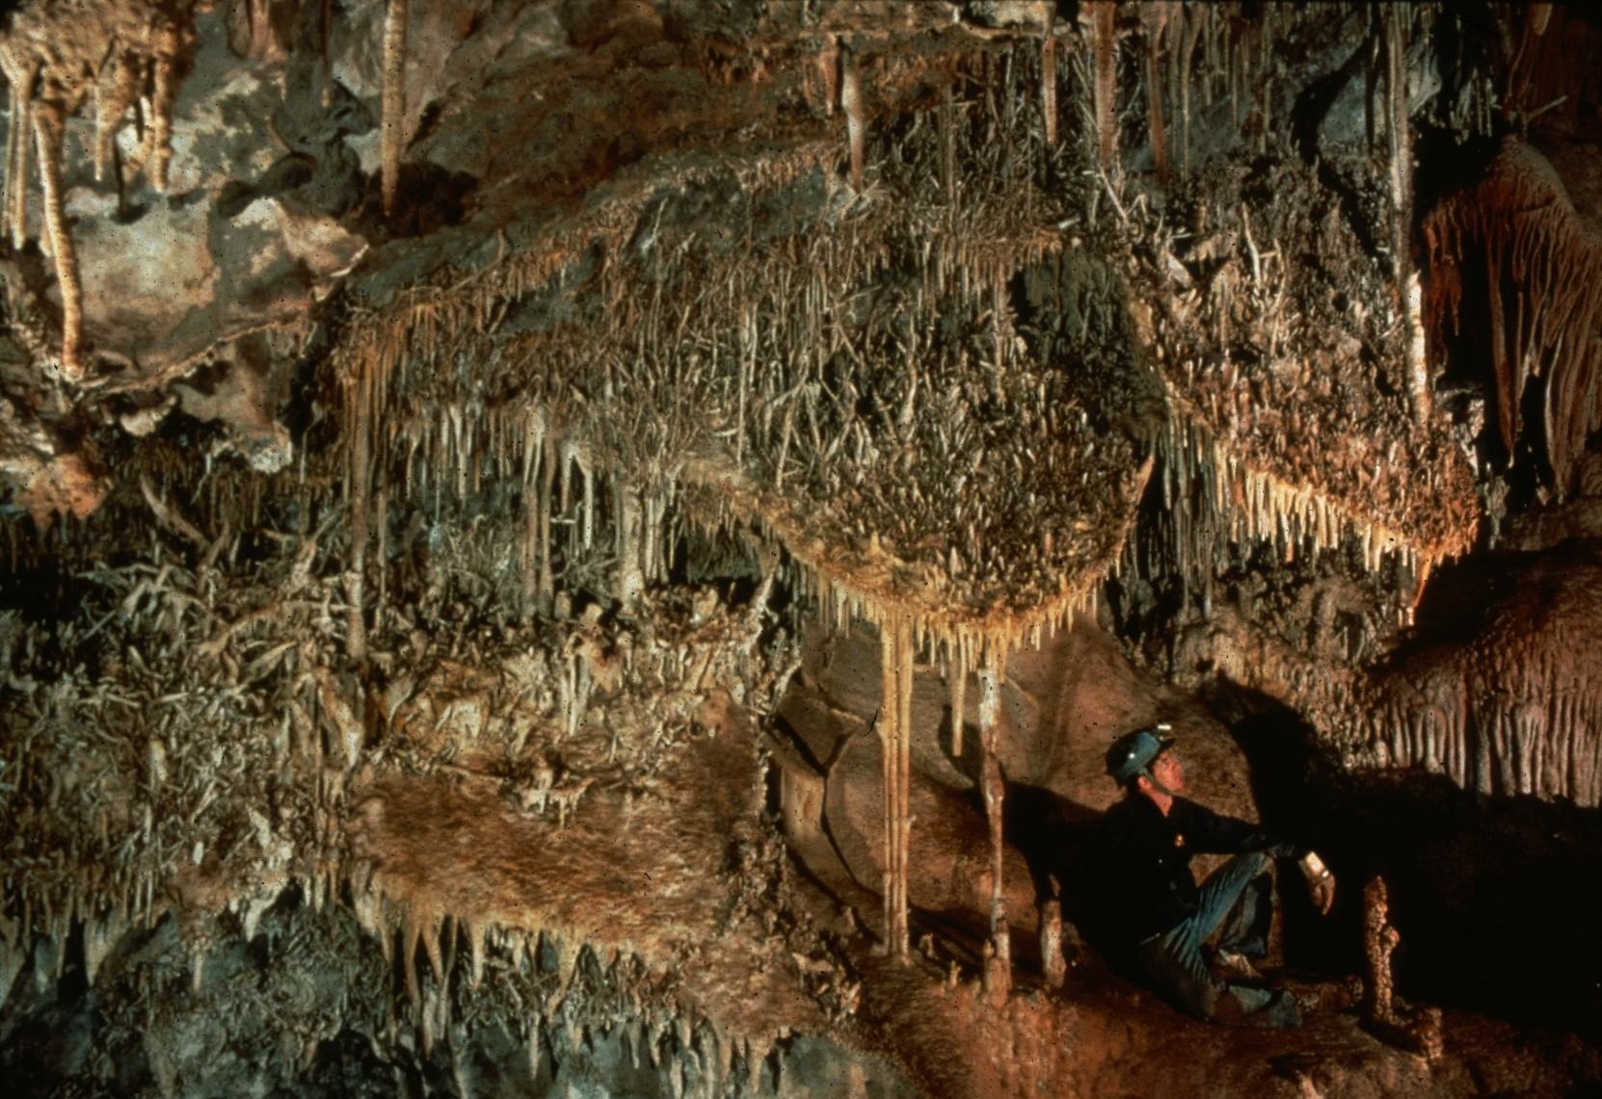
Notes:
Heligmitic Shields – Dave Bunnell

Slide 33
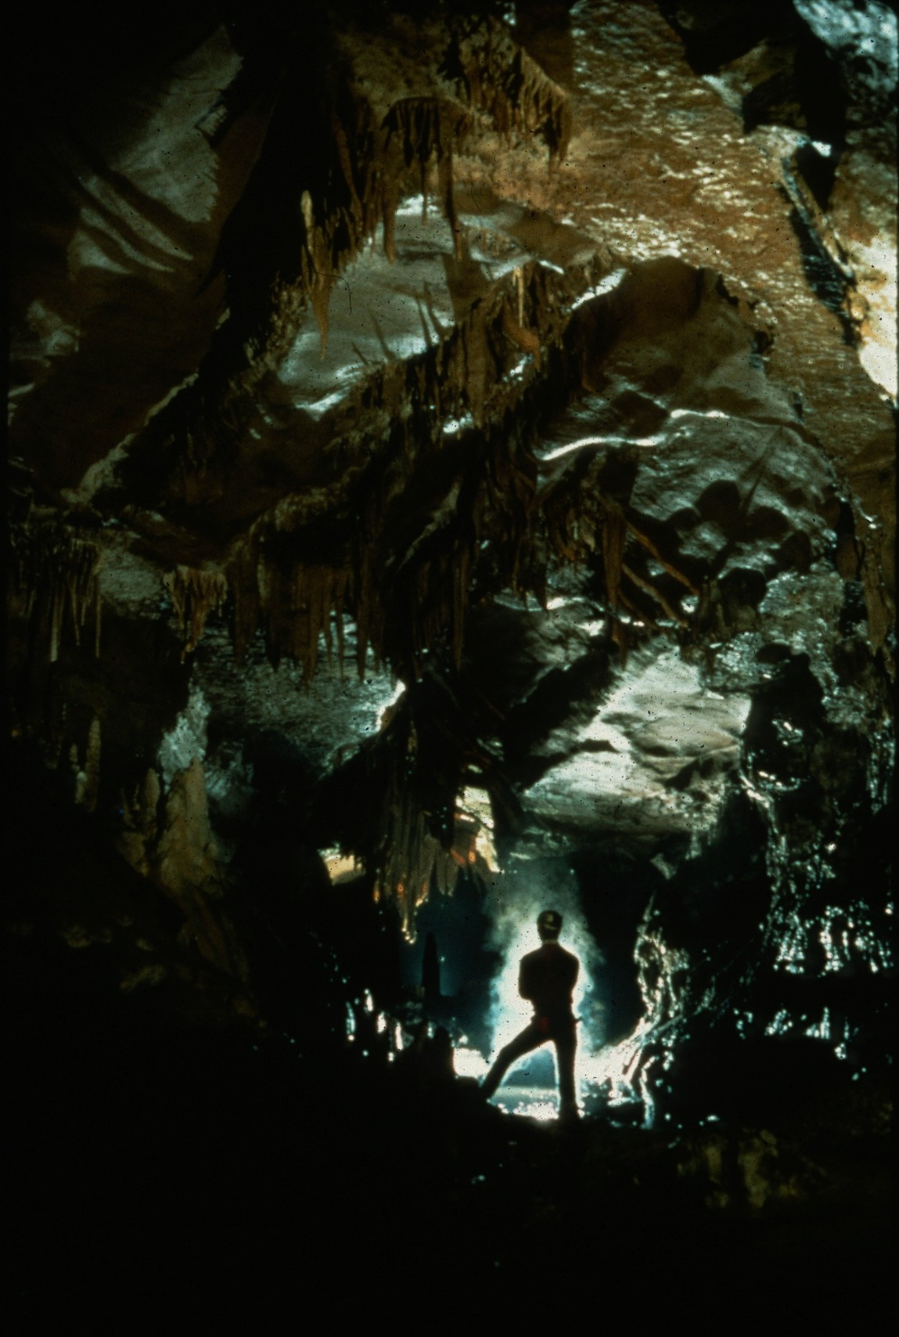
Notes:
Some Place Special – Ed McCarthy and Carl Samples

Slide 34
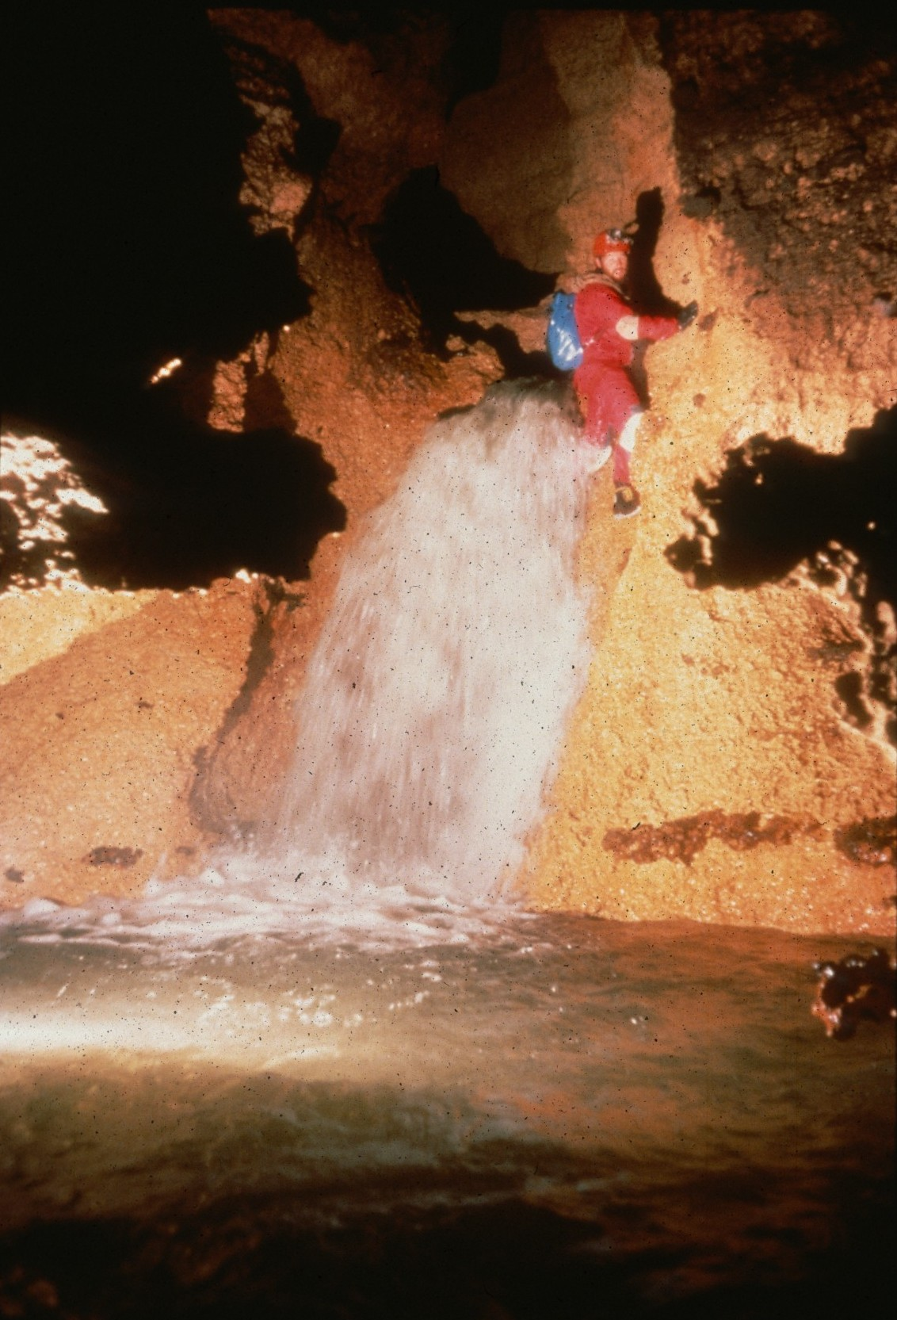
Notes:
Traverse – Ron Simmons

Slide 35
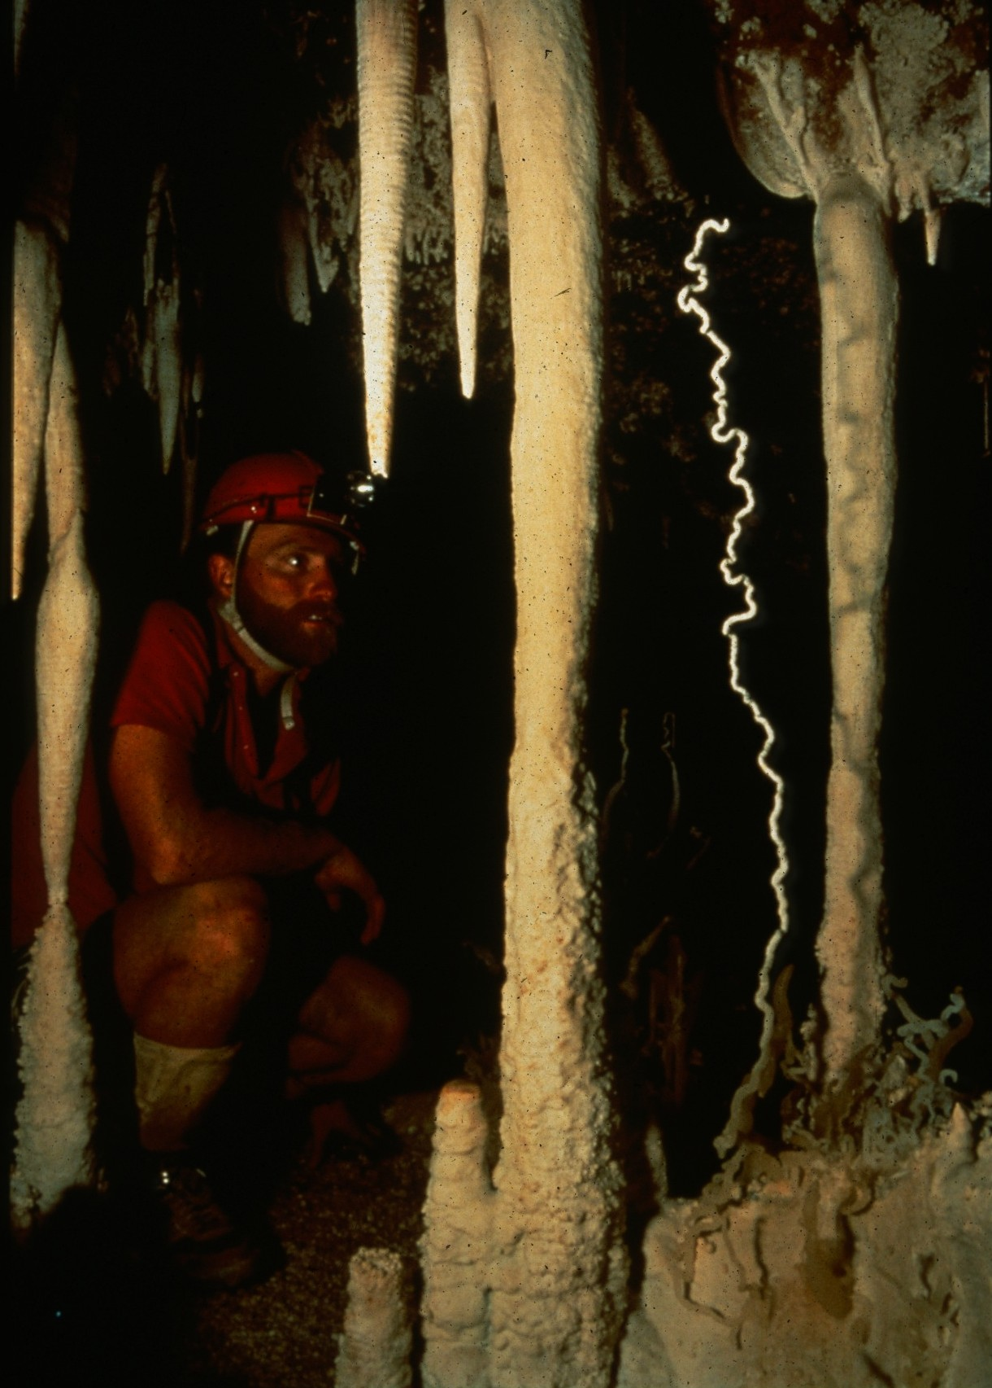
Notes:
Reward Of First Discovery – David L. Harris

Slide 36
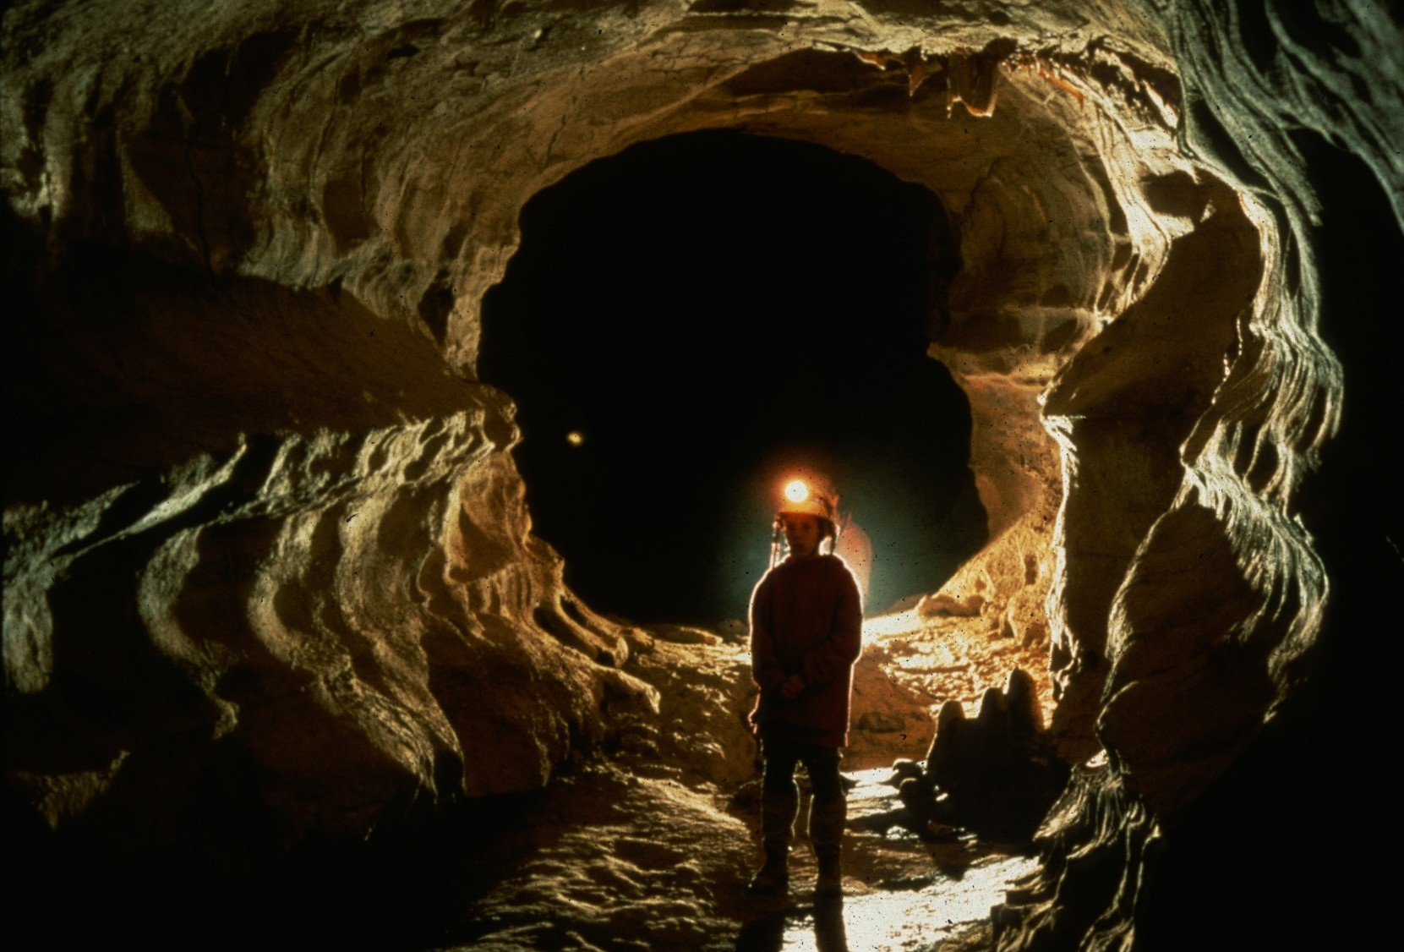
Notes:
Mellow Yellow – Ed McCarthy and Carl Samples

Slide 37
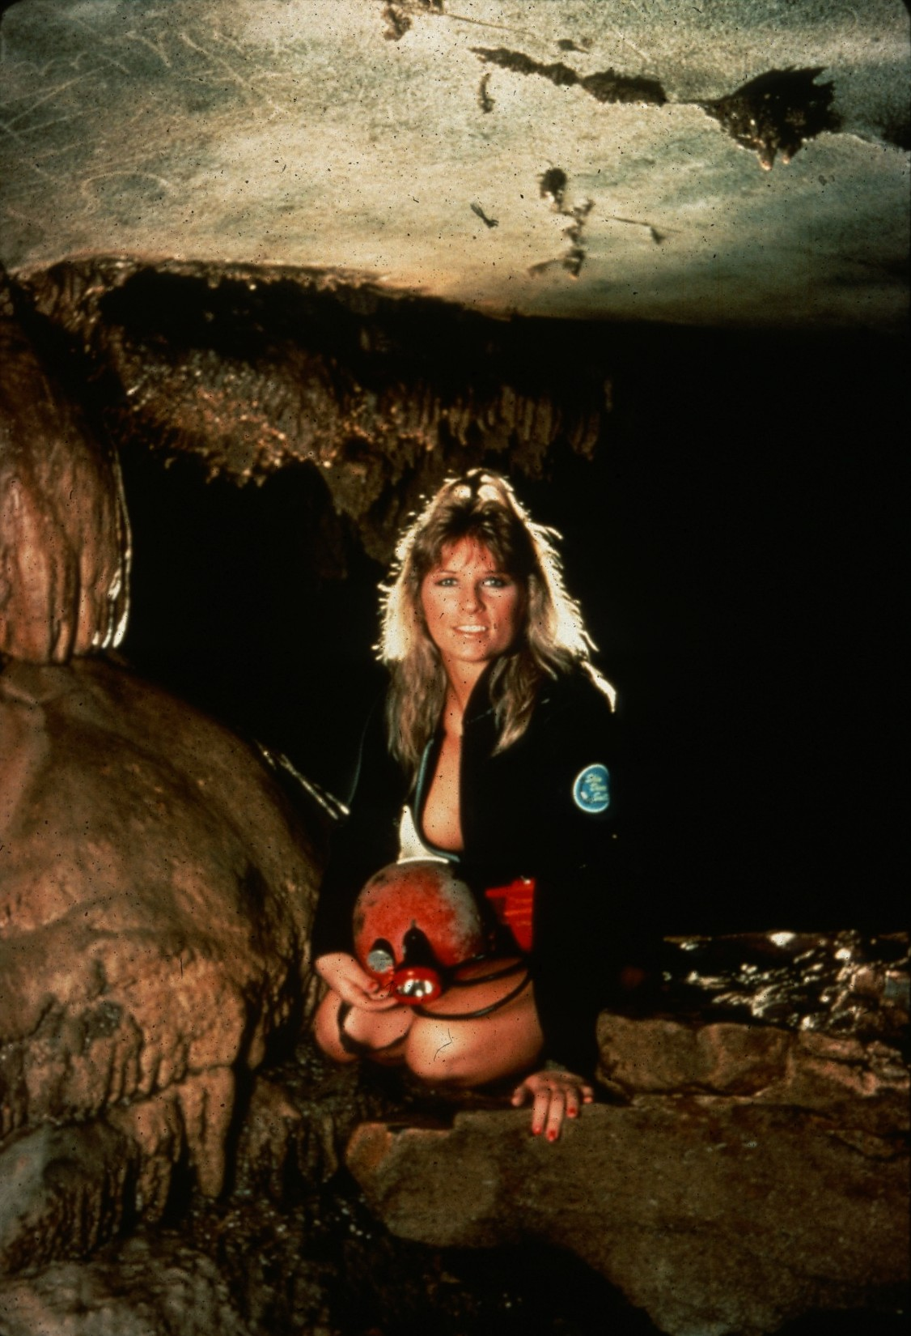
Notes:
Can I Come Along Too Fellows? – John Van Swearingen, IV

Slide 38
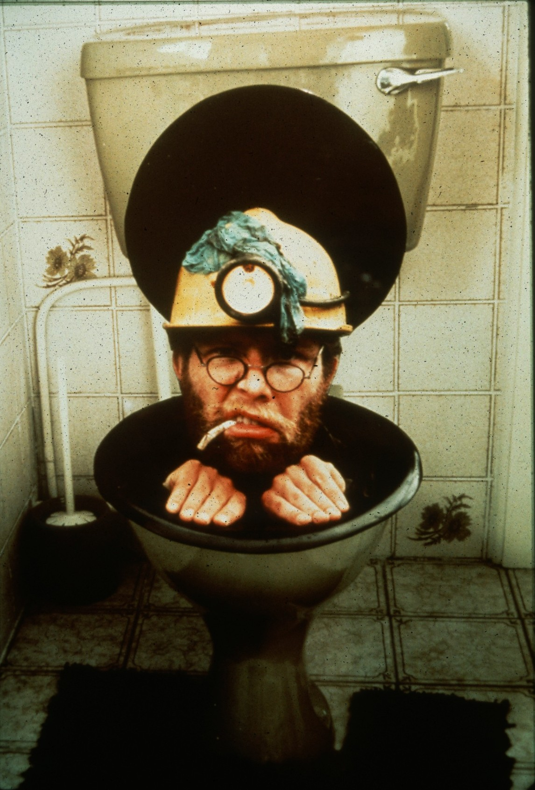
Notes:
Round The Bend – Chris Howes

Slide 39

HONORABLE MENTION
PHOTO SALON

Slide 40
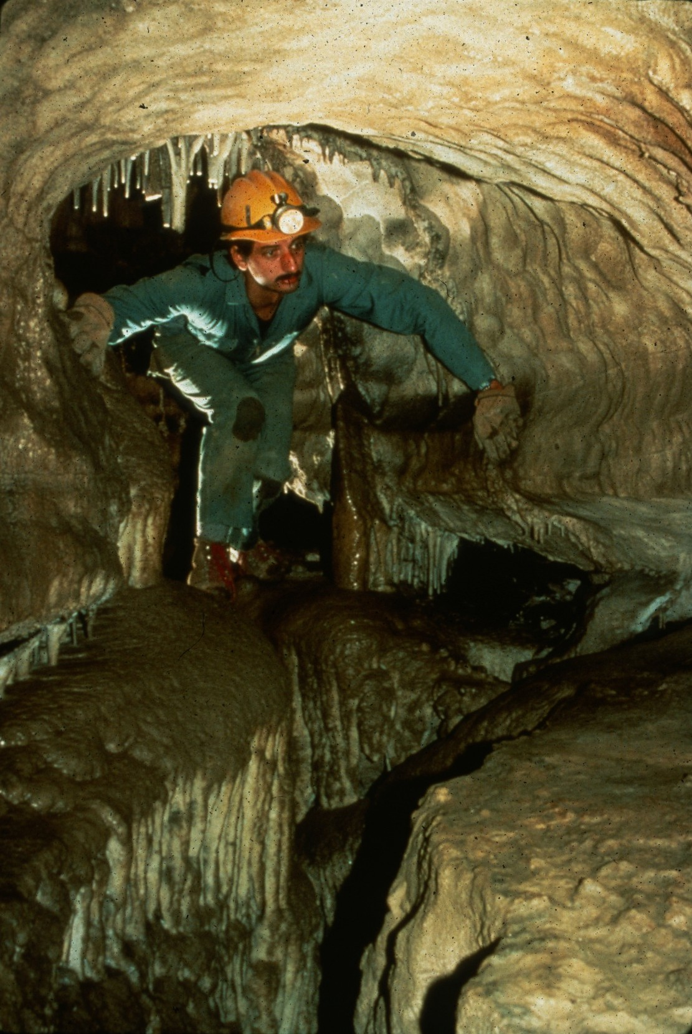
Notes:
Through the KeyHole – Peter and Ann Bosted

Slide 41
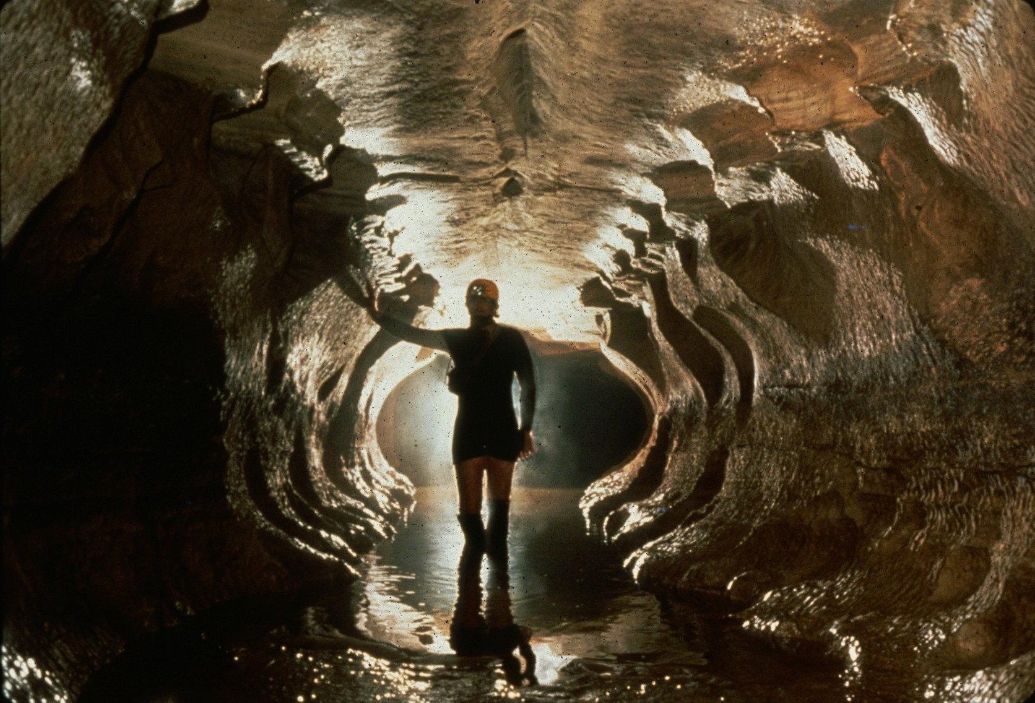
Notes:
Stream Dreams – Djuna Bewley

Slide 42
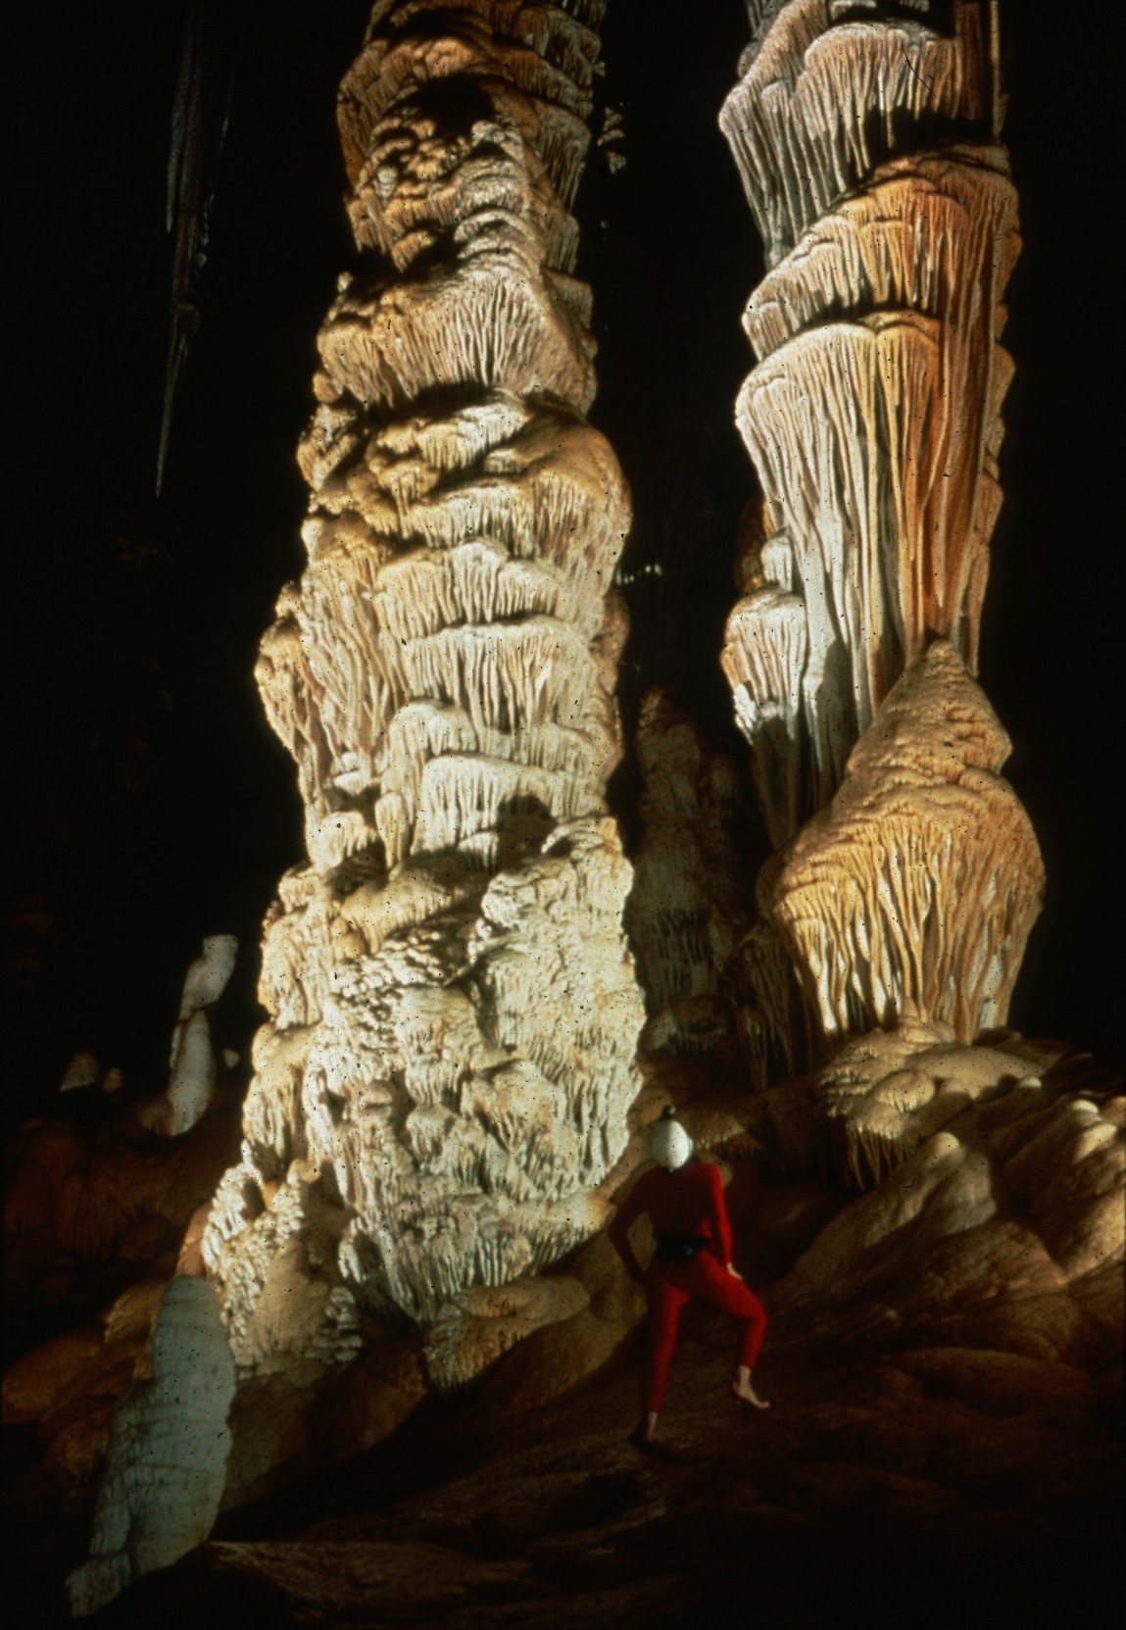
Notes:
Out Of This World – Peter and Ann Bosted

Slide 43
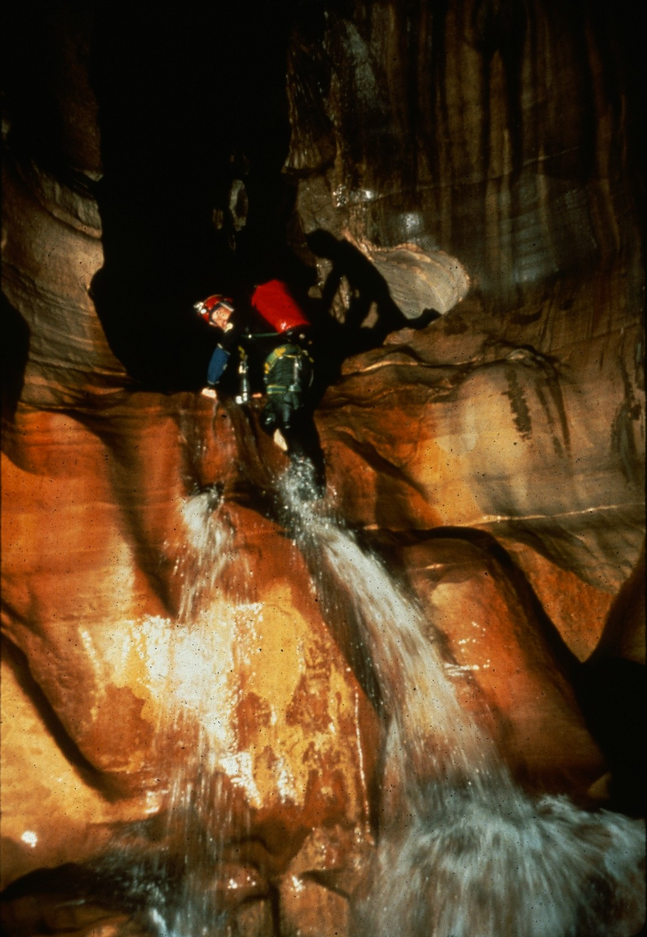
Notes:
Wet Dreams – Dave Bunnell

Slide 44
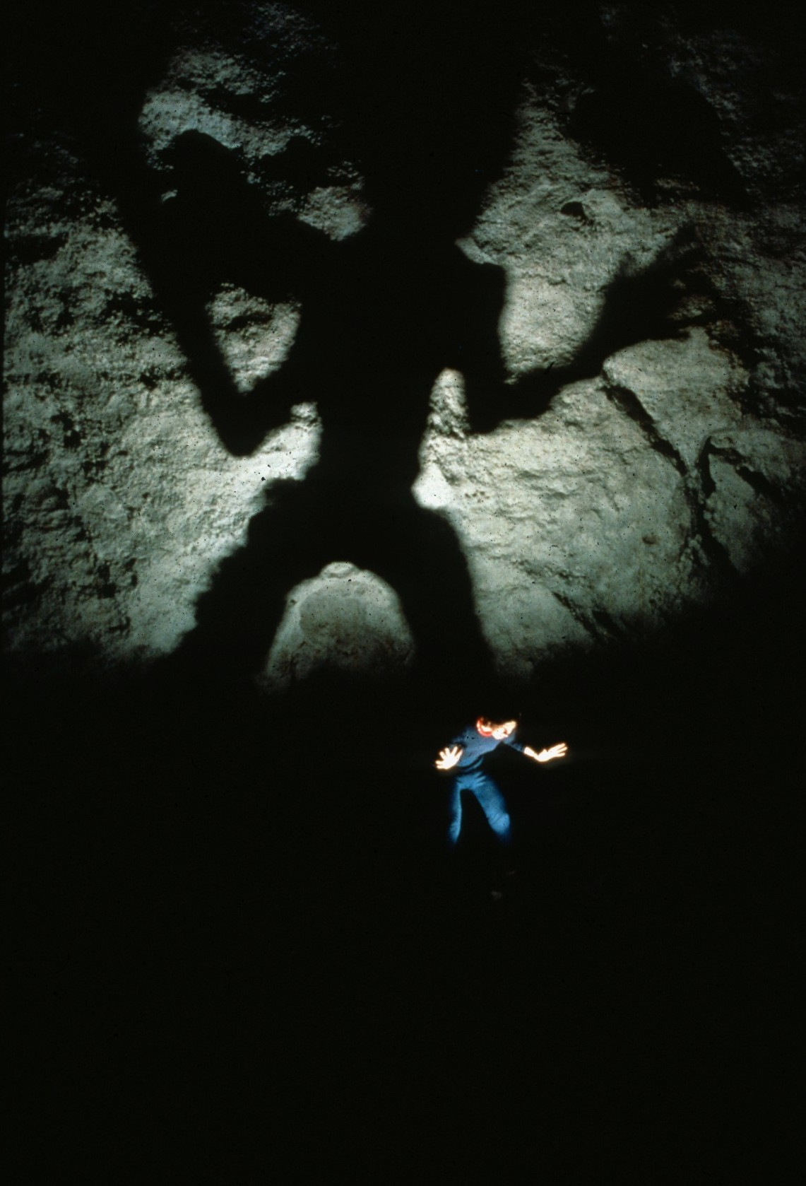
Notes:
Overshaddowed – Peter and Ann Bosted

Slide 45
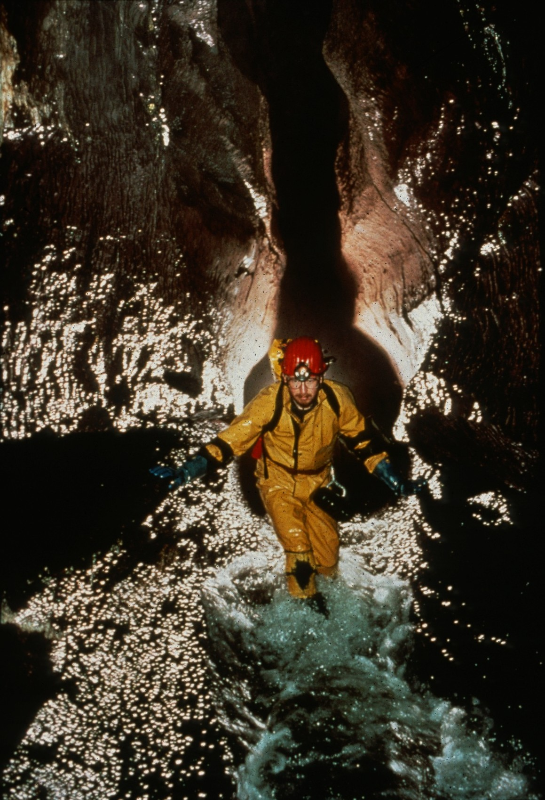
Notes:
Malcolm Stewart, Ogof Ffynnon Ddu – Chris Howes

Slide 46
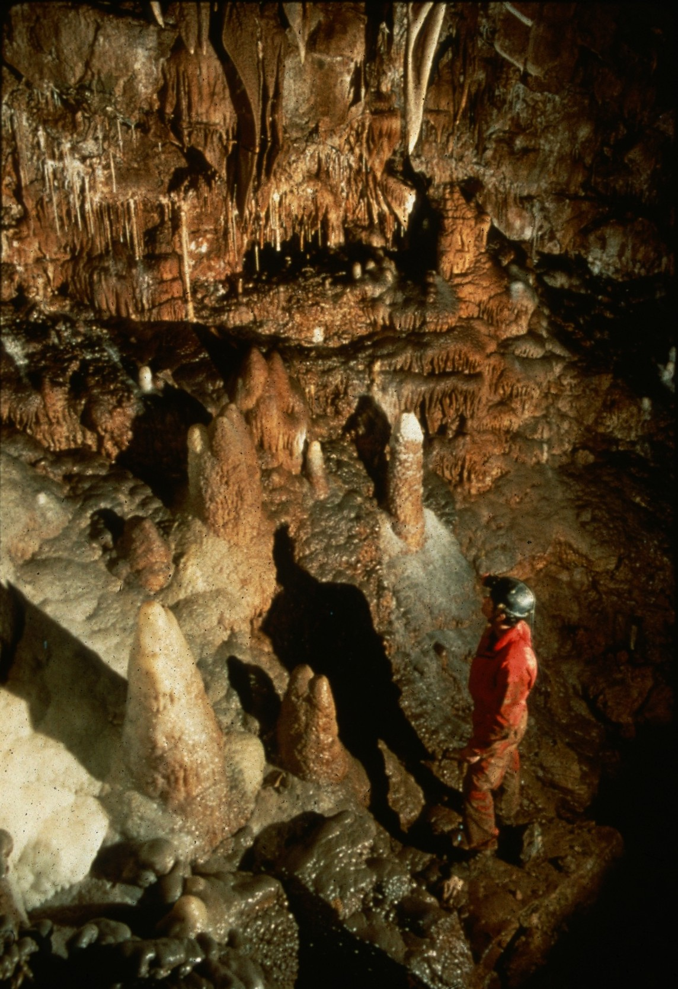
Notes:
Land Of Milk And Honey – Ed McCarthy and Carl Samples

Slide 47
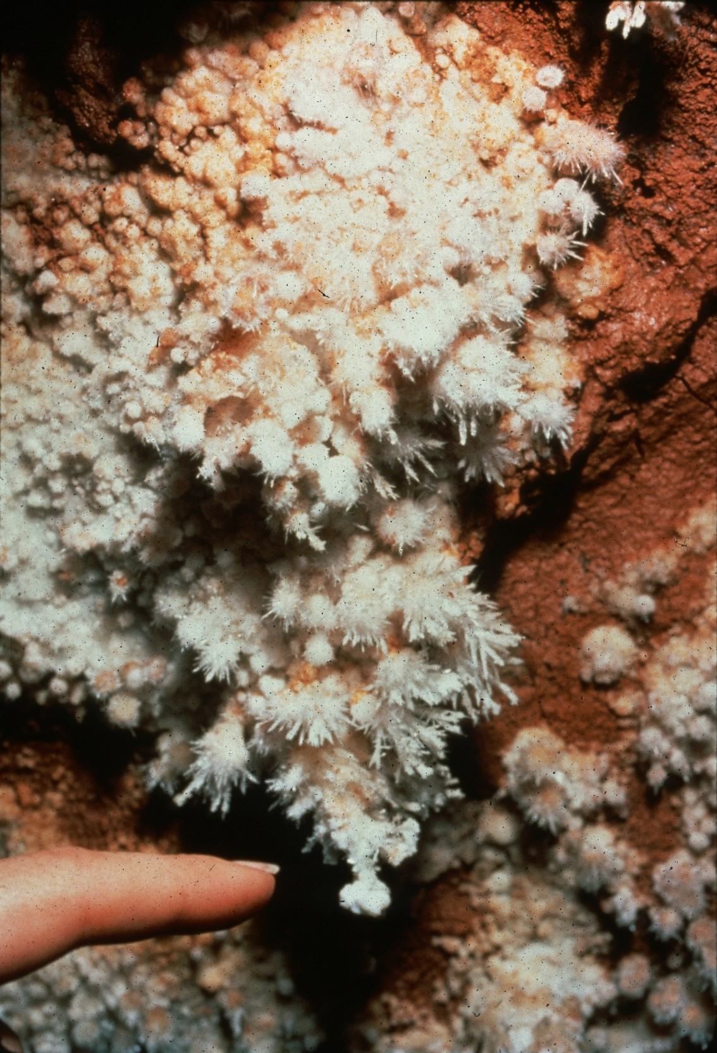
Notes:
Get The Point? – Jim Loftin

Slide 48
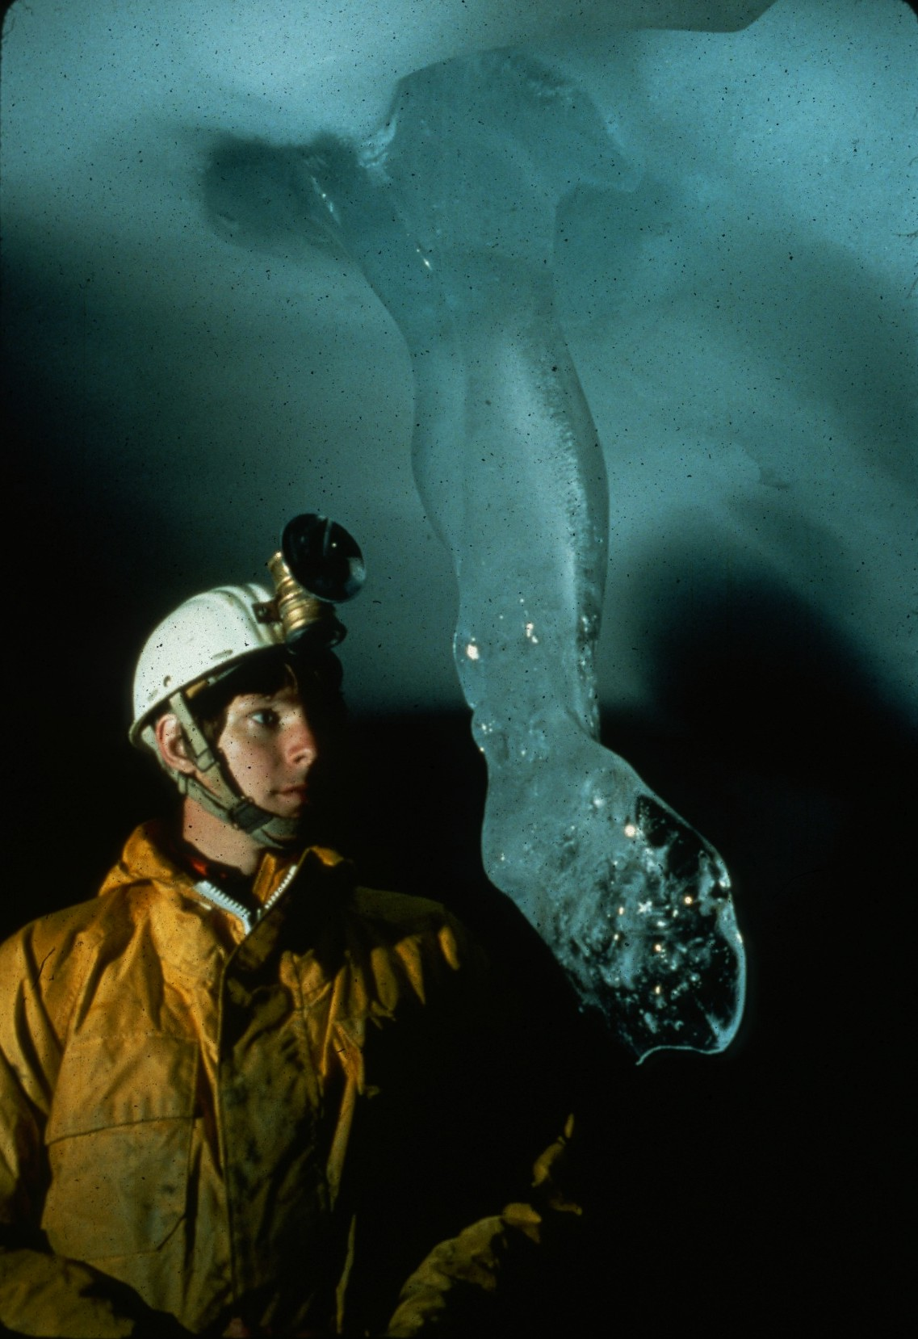
Notes:
The Sparkling Foot – Charles Anderson

Slide 49
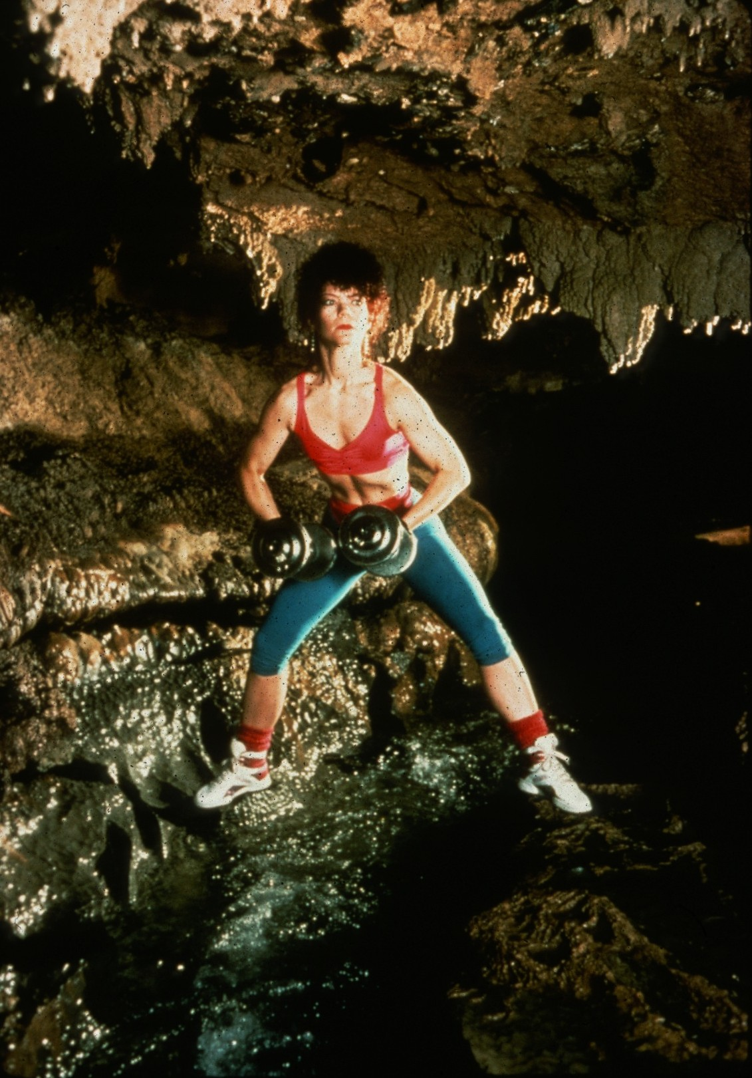
Notes:
Caving Is A Work Out – John Van Swearingen, IV

Slide 50
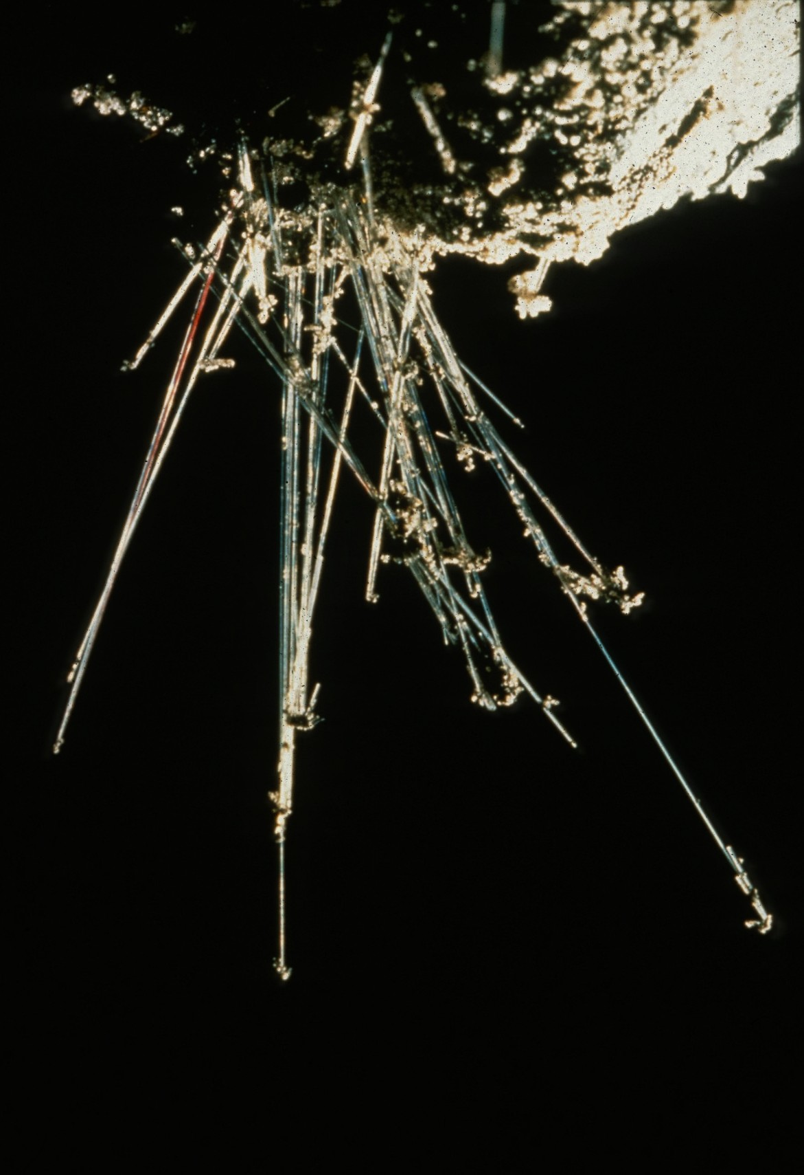
Notes:
Aragonite Crystals – Chris Howes

Slide 51
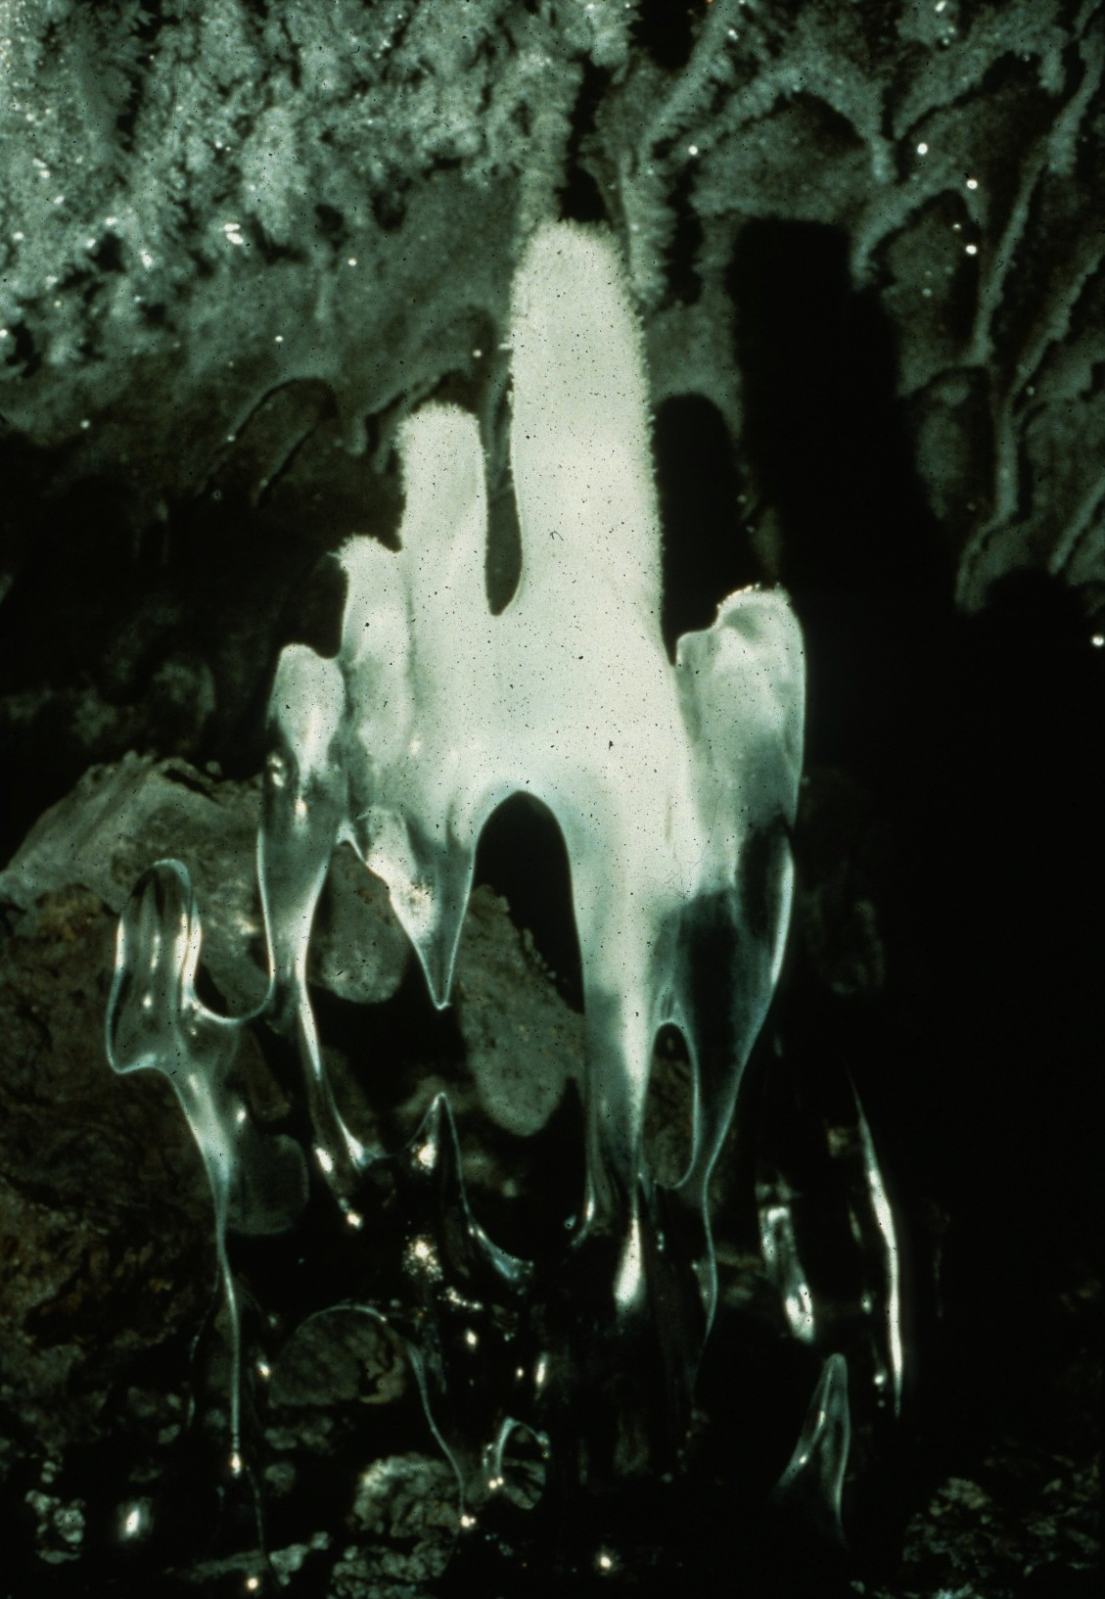
Notes:
I’m Melting – David Kesner

Slide 52
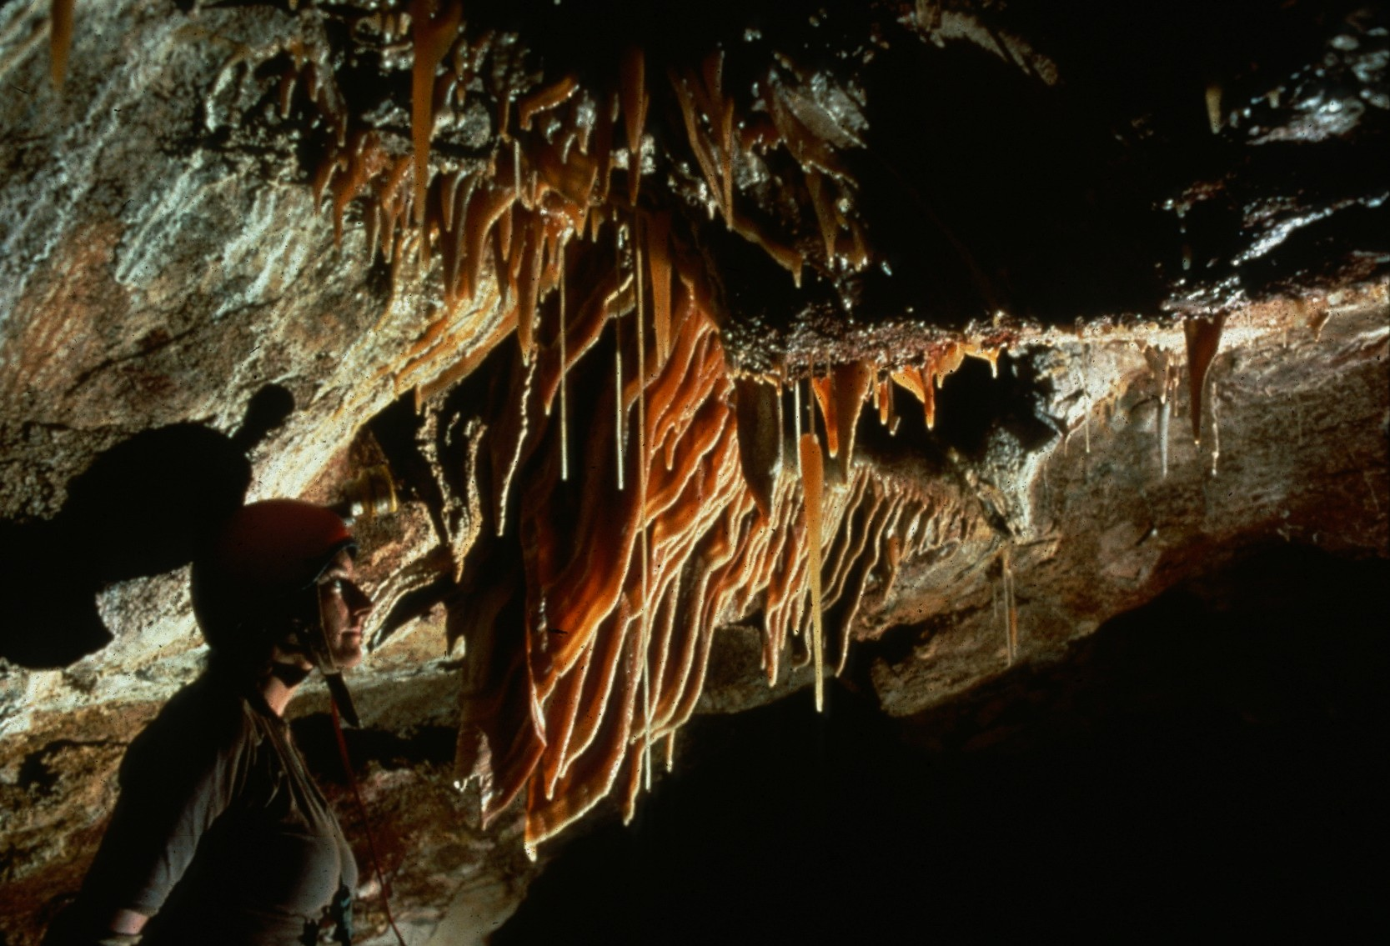
Notes:
Treasure Of The Dragon’s Lair – Dave Bunnell

Slide 53

Notes:
Generation Gap – Ed McCarthy and Carl Samples

Slide 54

Notes:
Onward – Ron Simmons

Slide 55

Notes:
Udder Delight – John Van Swearingen, IV

Slide 56

Notes:
Creature From The Mud Lagoon – Ed McCarthy and Carl Samples

Slide 57

Notes:
Stumped! – Peter and Ann Bosted

Slide 58

Notes:
Lavender Eve At Four Wells – John Van Swearingen, IV

Slide 59

Notes:
Downstream – Ron Simmons

Slide 60

Notes:
Lon In The Teeth – Peter and Ann Bosted

Slide 61

Notes:
Distinction – Richard Vernier

Slide 62

Notes:
…Still Going – Richard Vernier

Slide 63

MERIT AWARD
PHOTO SALON

Slide 64

Notes:
Julie Framed Over Rimstone – Dave Bunnell

Slide 65

Notes:
A Midwinter’s Dream – John Van Swearingen, IV

Slide 66

Notes:
Curtain Of Light – Ralph Earlandson

Slide 67

Notes:
Tandem Climb – David L. Harris

Slide 68

Notes:
Tiered Shelves – Dave Bunnell

Slide 69

Notes:
Up Tape – Ron Simmons

Slide 70

Notes:
The Climbing Wall – David L. Harris

Slide 71

Notes:
Twilight Zone, El Chorreadero – Dave Bunnell

Slide 72

Notes:
Short Drop – John Van Swearingen, IV

Slide 73

Notes:
Gold Ice – David Kesner

Slide 74

Notes:
Among the Gnomes – Ed McCarthy and Carl Samples

Slide 75

Notes:
Chenille Basin Climb – David L. Harris

Slide 76
BEST OF SHOW
PHOTO SALON

Slide 77

Notes:
Up-In-Arms – Peter and Ann Bosted

Slide 78
Photographers

Slide 79
Photographers:
  Charles Anderson
  Djuna Bewley
  Peter and Ann Bosted
  Dave Bunnell
  Richard Chiasson
  Ralph Earlandson
  David L. Harris
  Chris Howes
  Jay Jordon

Slide 80
Photographers:
  David Kesner
  Jim Loftin
  Ed McCarthy & Carl Samples
  Ken Oeser
  Al Ogden
  Ron Simmons
  John Van Swearingen, IV
  Richard Vernier

Slide 81

An NSS Audio-Visual Library Presentation
The Best of the
1993 NSS Photo Salon
Original slide program S916
Slides digitized by David Caudle
PowerPoint program created by Jim McConkey
70 slides, with script in presenter notes
PowerPoint created 2/28/2021
National Speleological Society
6001 Pulaski Pike
Huntsville, AL 35810-1122
256- 852-1300
nss@caves.org
https://caves.org/

